Slide 1
El Paso Electric
My Summer Externship

Slide 2
What is your plan after high school?
Military Service?
Continue your degree?
Join the workforce?

Slide 3
Options with El Paso Electric

Slide 4
Internships
Grid Internship
Designed for local college and university students
Provide work experience
Professional development opportunities
Networking
Potential job offer upon graduation
Summer College Internship
Designed for students who are not going to school in the EPE service area
Similar goals as Grid Internship

Slide 5
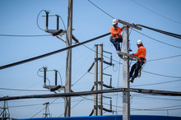
Lineworker Apprenticeship
Enroll at Doña Ana Community College Lineworker Certification Program
Program is 1 year plus on the job training
Helper-Apprentice 6-8 months
Apprentice 4 years
Lineworker – over $31/hour
Overtime, holiday pay

Slide 6
Department & Employee Highlights

Slide 7
Departments that I visited
Human Resources
System Operations
Business Intelligence
Distribution Operations
EMS Applications
OT Infrastructure
Asset Management Services
GIS Mapping & Programming
Configuration of Software Applications
Meter Technology & Testing
Load Research & Data Analytics
Rio Grande Power Plant
Electrification of Transportation

Slide 8
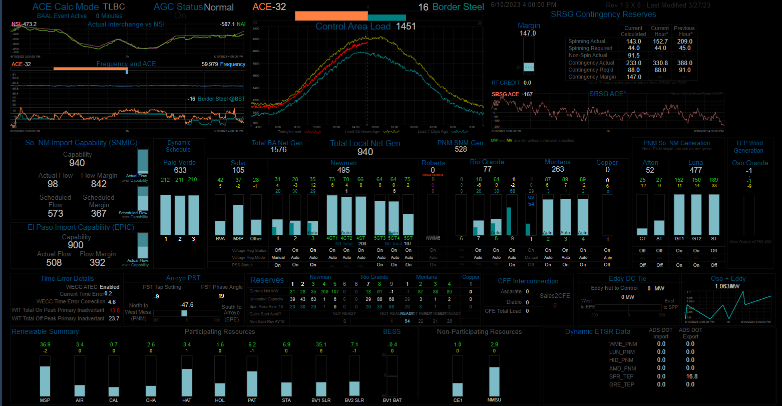

Slide 9
Employee Feedback and Advice
Many didn’t feel that their high school or counselor gave them many options
Many came from El Paso, Juarez, and a few from out of town or state
Majors:
Computer Science
Engineering (Electrical, Computer, Network, Electronics)
Economics
Started with Cisco certificate then continued degree while working
MBA
Associate Degree in Drafting & Design
Geography

Slide 10
Employee Feedback and Advice
Math is very important
Were interested in something as teenagers in high school or college
Build your resume with experience and internships
Network with classmates, peers, coworkers
Continue learning (certificates, degrees, training)
Find what you really enjoy
Ask & learn from others

Slide 11
Why Employees Chose El Paso Electric
Benefits
Flexibility
Salary
Job Satisfaction
Opportunity for Growth

