Slide 1
+
EL PASO HIGH SCHOOL
PROJECT FINE ARTS ADDITION + INTERIOR RENOVATIONS
COMMUNITY MEETING
September 28, 2017
EPISD 2016 Bond Program

Slide 2
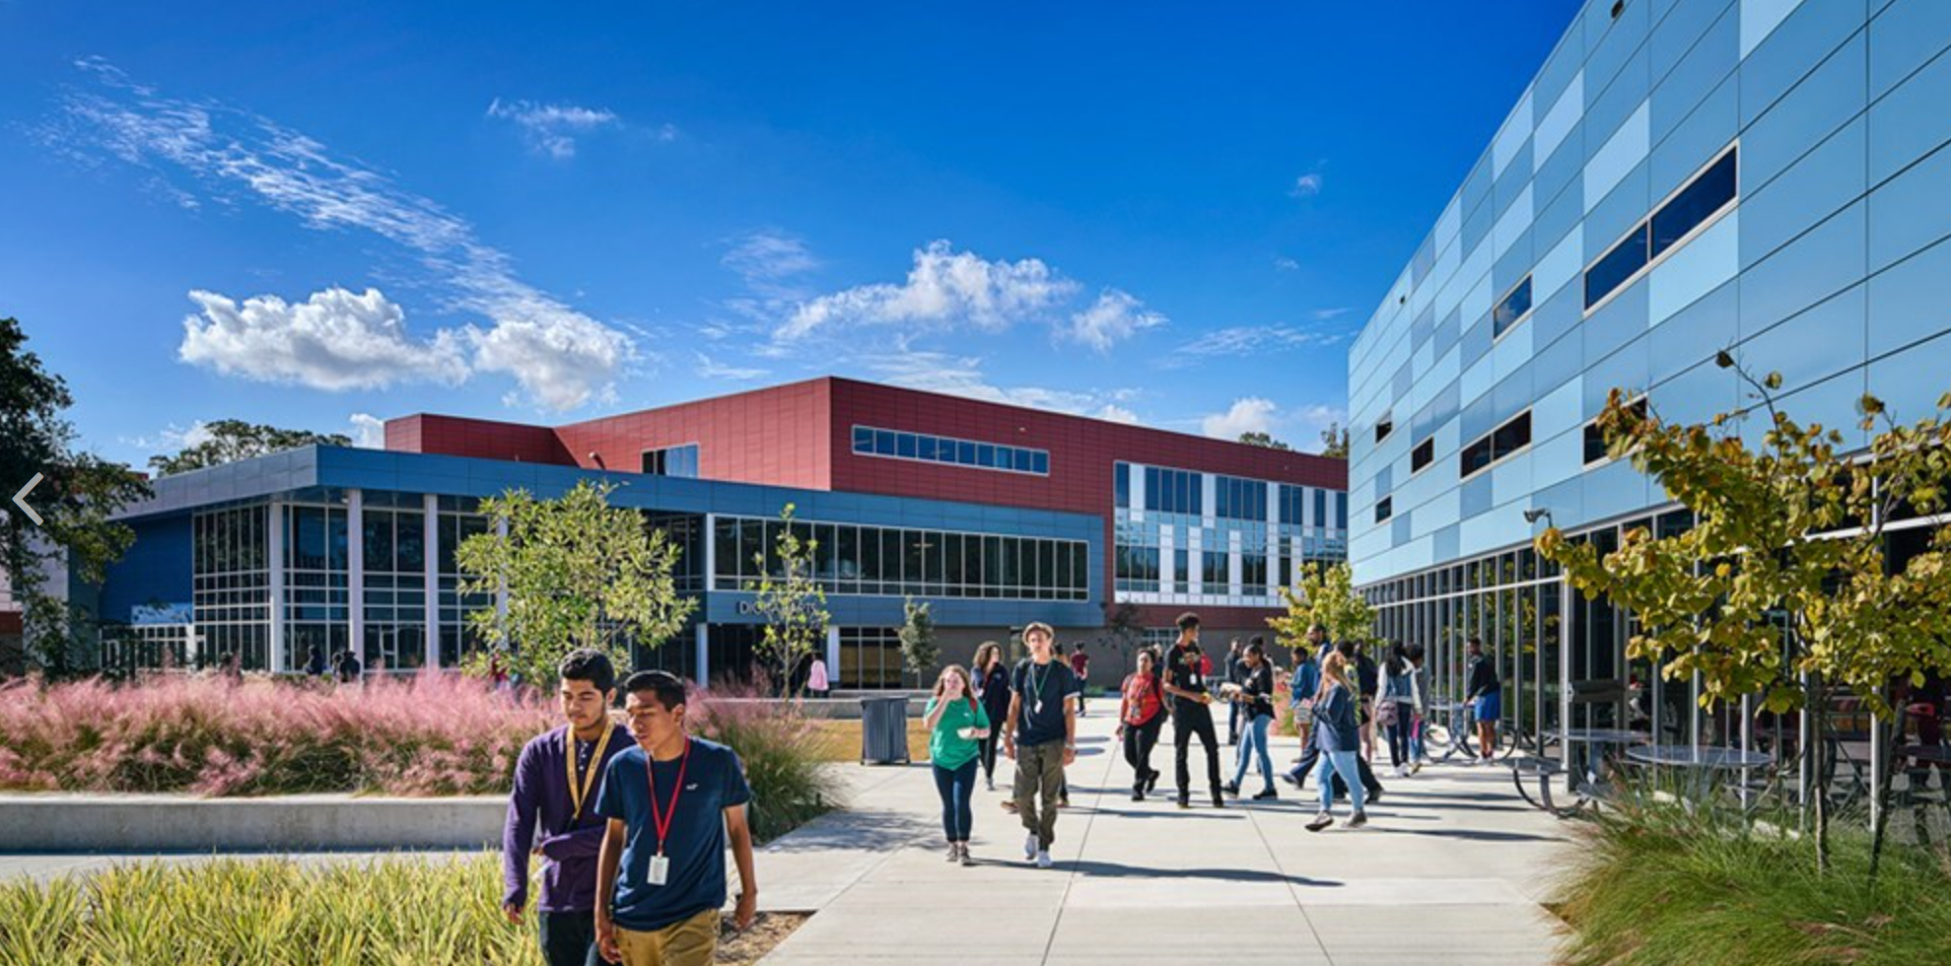
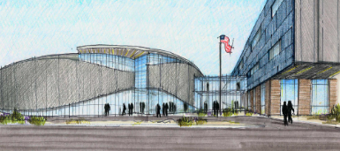
PROGRAM PHASE OVERVIEW
DESIGN | CONSTRUCTION TIMELINE
BUDGET
PHASING : SITE PLANNING + INTERIOR RENOVATIONS
TEAM EXERCISE : METHODOLOGY
TEAM EXERCISE : MATERIALS
NEXT
Q+A
+

Slide 3
PROGRAMMING PHASE
OVERVIEW

Slide 4
INTERIOR RENOVATIONS PROGRAMMING
GSF = APPROX 15,890
Academic Core
Home Room Classrooms
Science Lab + Storage
Administration
Student Activities Area
Auditorium
Drama Classroom
Tech Craft
Storage
Restrooms | Circulation
Female Restrooms on Floors 1-4
Male Restrooms on Floors 1-4
Select Accessibility Ramps
Select Corridor Section
Elevator
+

Slide 5
FINE ARTS ADDITION PROGRAMMING
GSF = APPROX 32,000
Academic Core
Art Classrooms + Storage (2)
Kiln (1)
Wet Room (1)
Office (1)
Ancillary Instruction
Piano Room + Storage
Guitar Room + Storage
Digital Music Production Studio
Choir Room
. Practice Rooms
. Ensemble Room
. Music Library
. Robe + Instructional Storage
. Office
Administration
Community Room
Restrooms | Circulation
Female Student Restroom
Male Student Restroom
Female Staff Restroom
Male Staff Restroom
Orchestra Room
. Practice Rooms
. Ensemble Room
. Instrument + Instructional Storage
. Office
Band Room
. Practice Rooms
. Ensemble Room
. Other Music Space
. Instrument Storage
. Uniform + Instructional Storage
. Female + Male Dressing Room
. Office
+

Slide 6
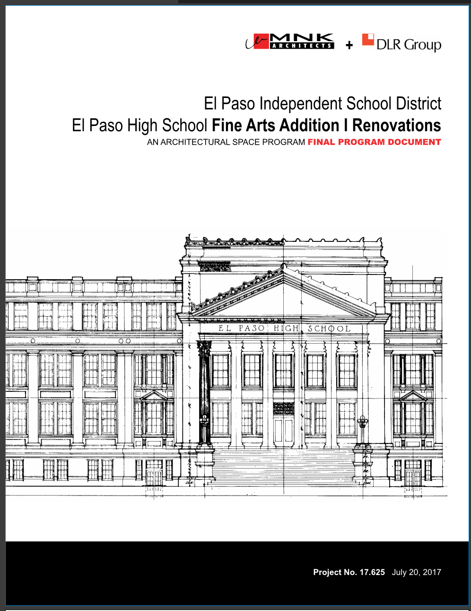

Slide 7
PROGRAM PHASE OVERVIEW
DESIGN | CONSTRUCTION TIMELINE
BUDGET
PHASING : SITE PLANNING + INTERIOR RENOVATIONS
TEAM EXERCISE : METHODOLOGY
TEAM EXERCISE : MATERIALS
NEXT
Q+A
+

Slide 8
SCHEDULE
Schematic Design COMPLETE BY DECEMBER 2017
Owner Review
Design Development COMPLETE BY MARCH 2018
Owner Review
Construction Documents COMPLETE BY JULY 2018
Bidding | Negotiation | Contract Execution COMPLETE BY FALL 2018
Phase 1 – Fine Arts Addition ANTICIPATED COMPLETION DATE END OF 2019
EPISD Move Activation
Phase 2 – Interior Renovations ANTICIPATED COMPLETION DATE FALL OF 2020
+

Slide 9
PROGRAM PHASE OVERVIEW
DESIGN | CONSTRUCTION TIMELINE
BUDGET
PHASING : SITE PLANNING + INTERIOR RENOVATIONS
TEAM EXERCISE : METHODOLOGY
TEAM EXERCISE : MATERIALS
NEXT
Q+A
+

Slide 10
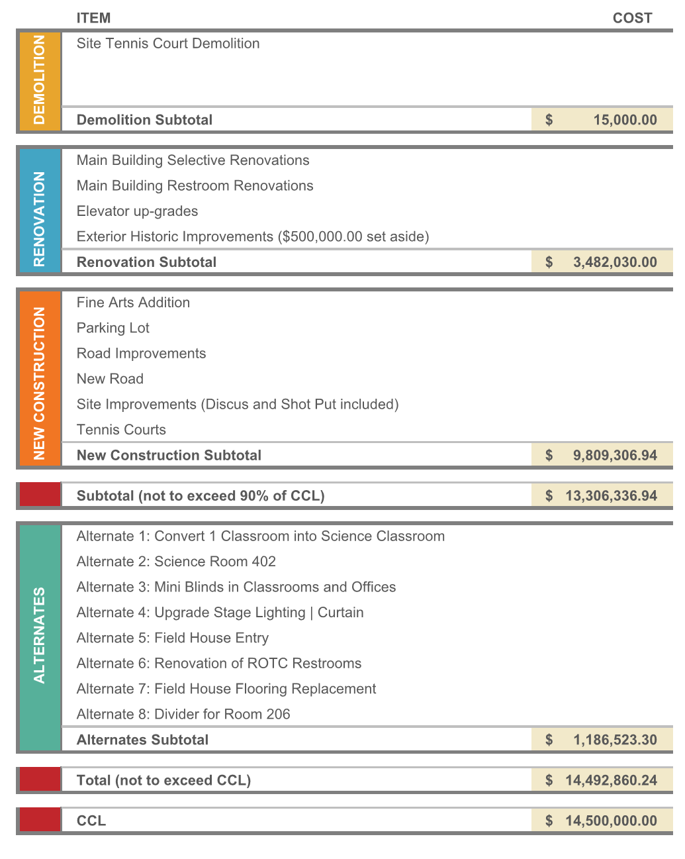
BUDGET
+

Slide 11
BUDGET
+

Slide 12
PROGRAM PHASE OVERVIEW
DESIGN | CONSTRUCTION TIMELINE
BUDGET
PHASING : SITE PLANNING + INTERIOR RENOVATIONS
TEAM EXERCISE : METHODOLOGY
TEAM EXERCISE : MATERIALS
NEXT
Q+A
+

Slide 13
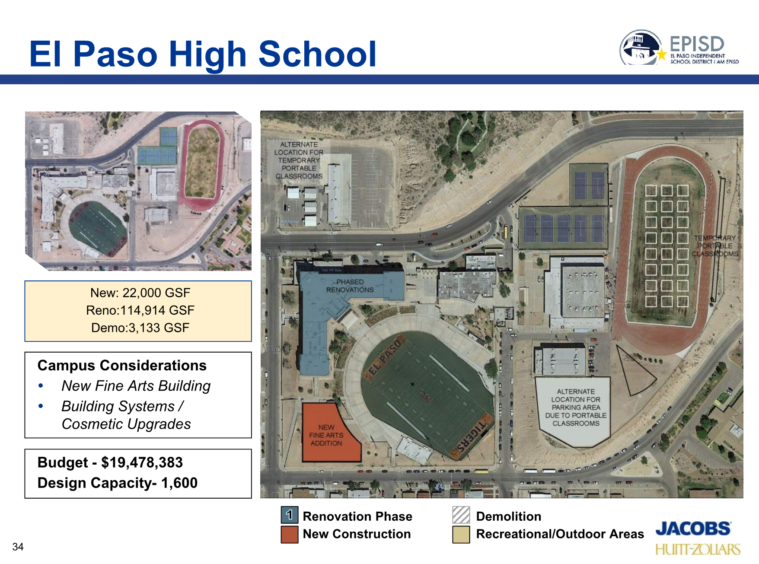
JACOBS Sprint Start Project Slides

Slide 14
VALUE | CRITERIA
CATEGORIES

Slide 15
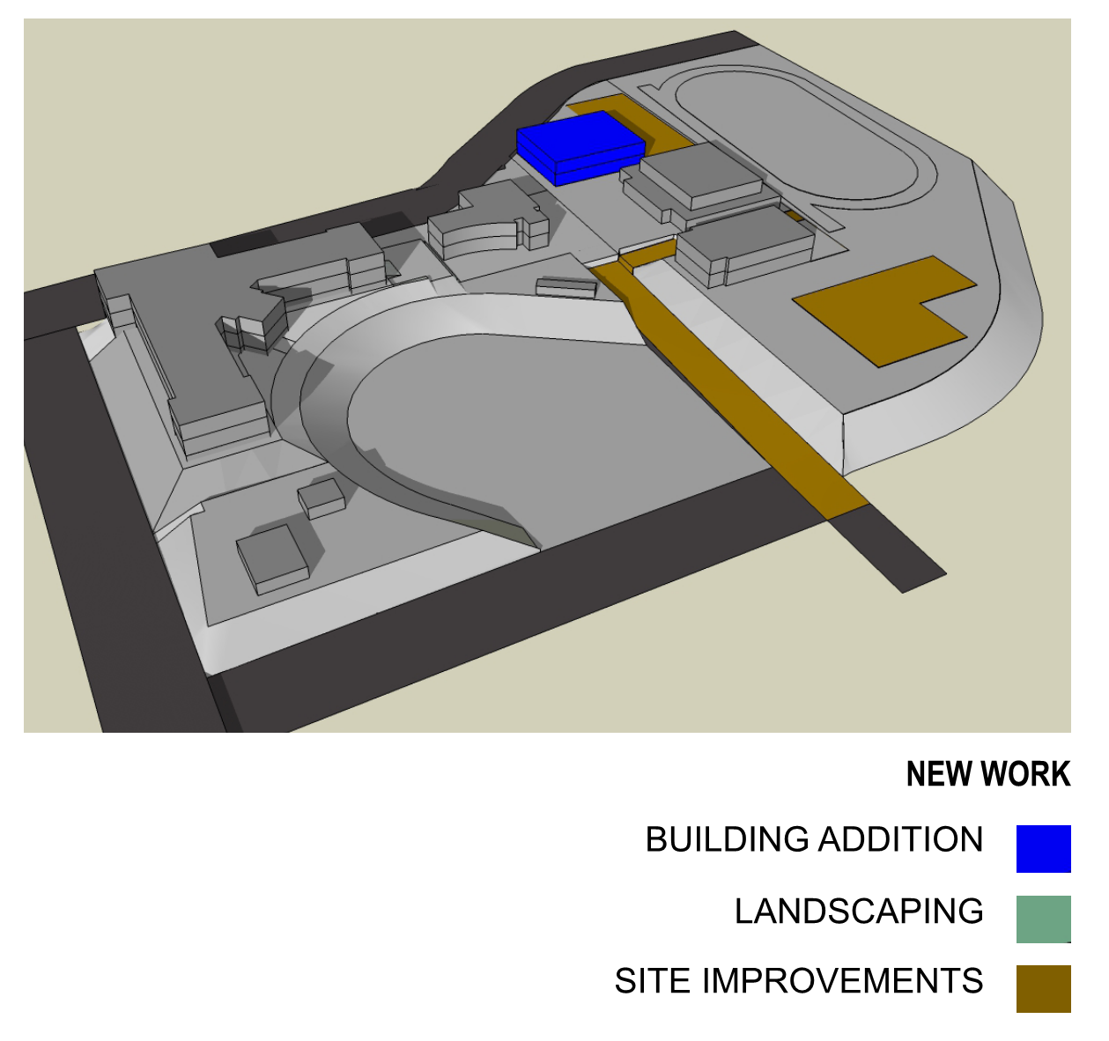
PROPOSED
SITE PLAN

Slide 16
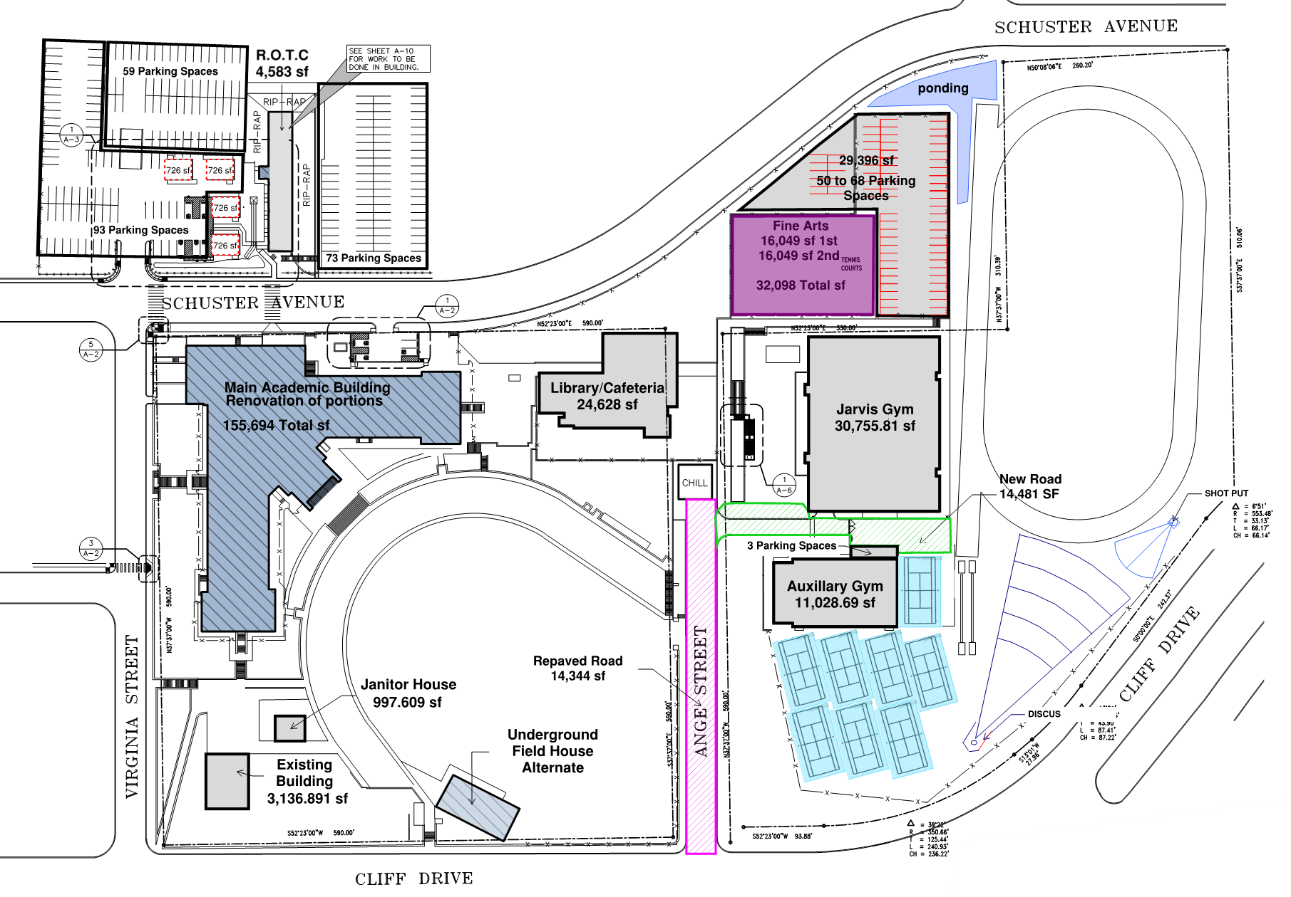
APPROVED
SITE PLAN

Slide 17
INTERIOR RENOVATIONS

Slide 18
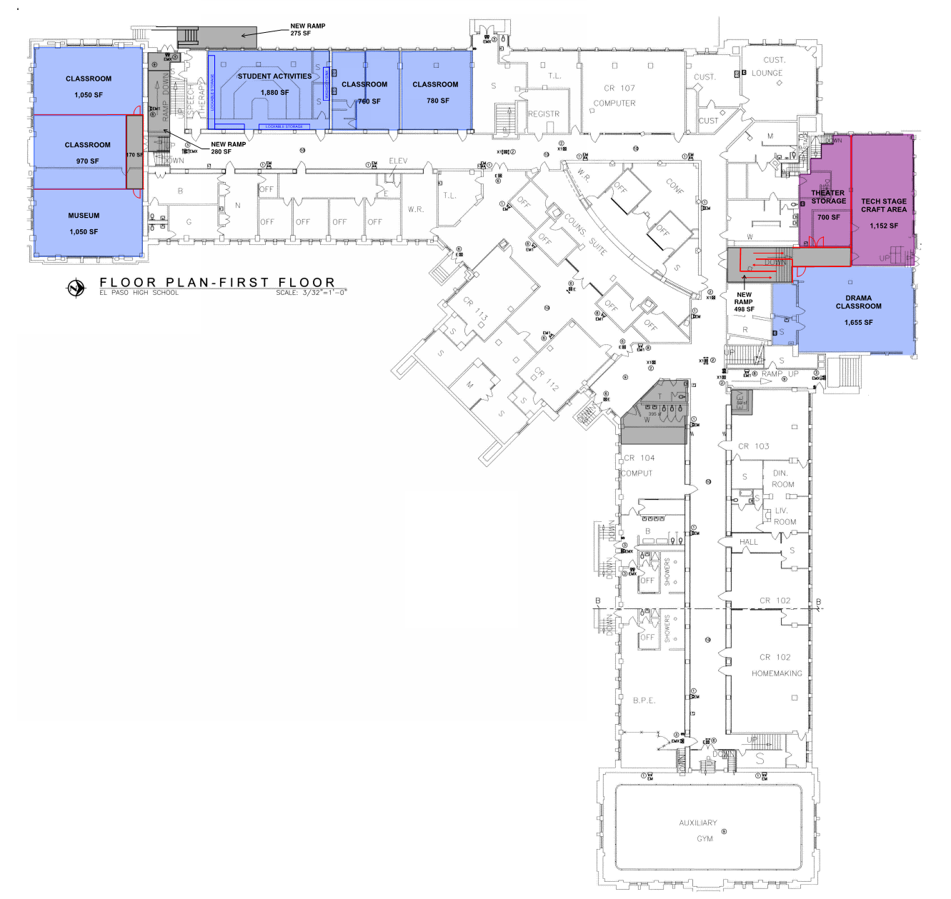
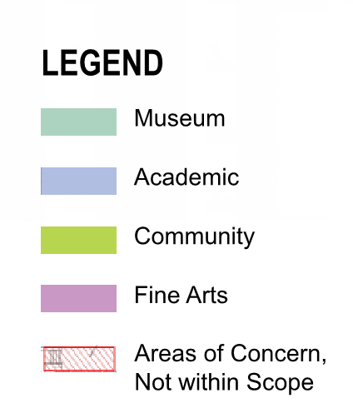
| Administrative
Alternates

Slide 19
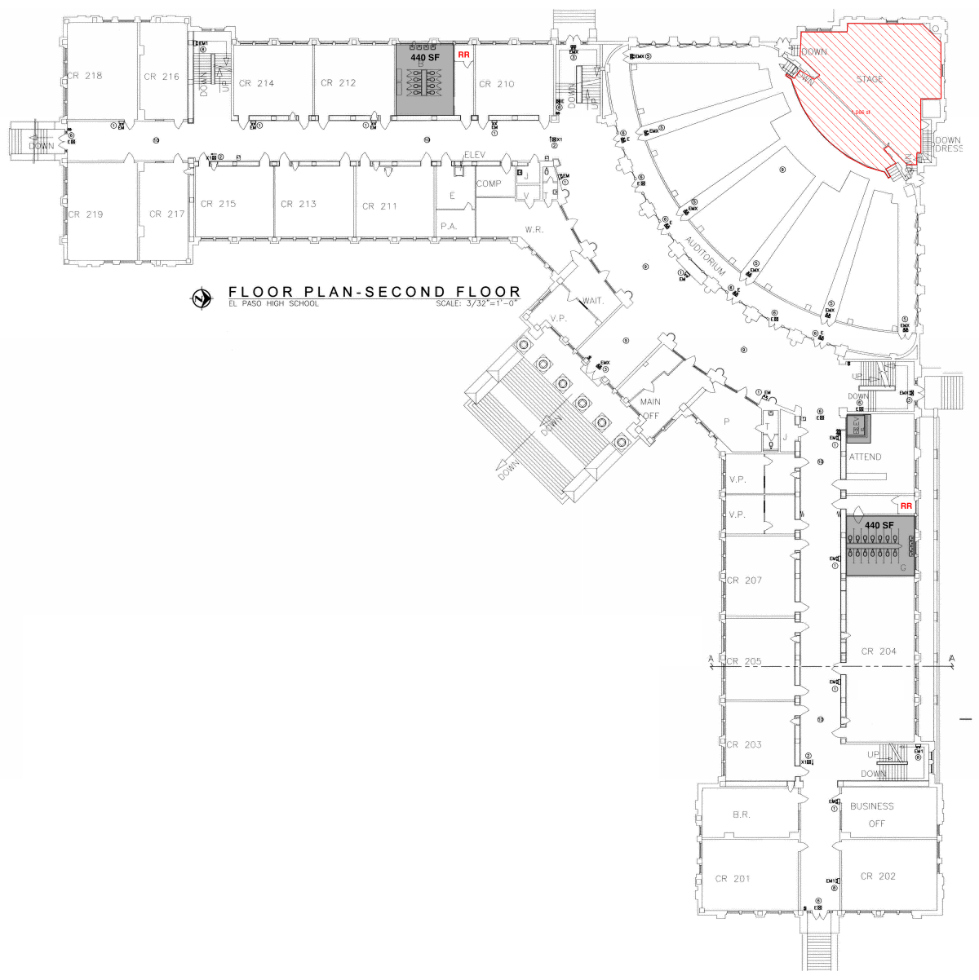
| Administrative
Alternates

Slide 20
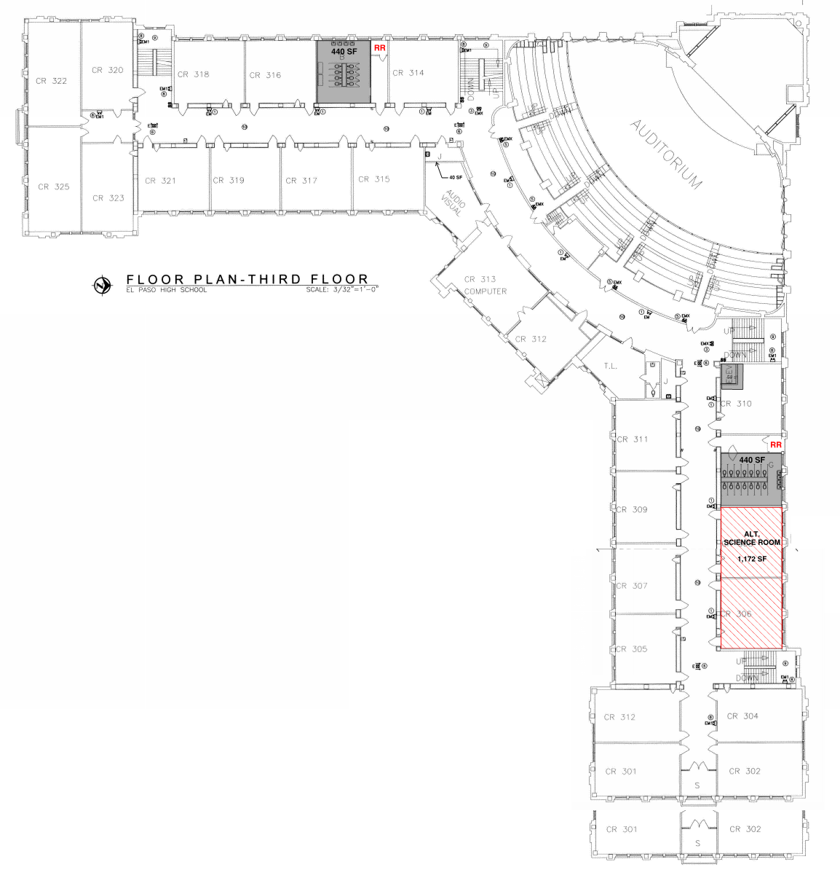
| Administrative
Alternates

Slide 21
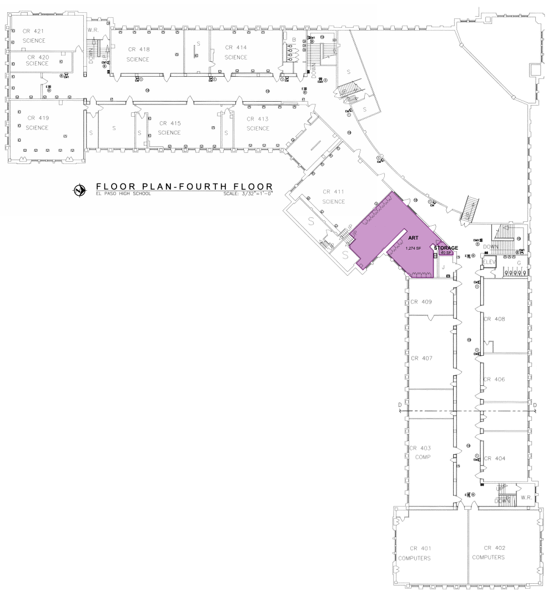
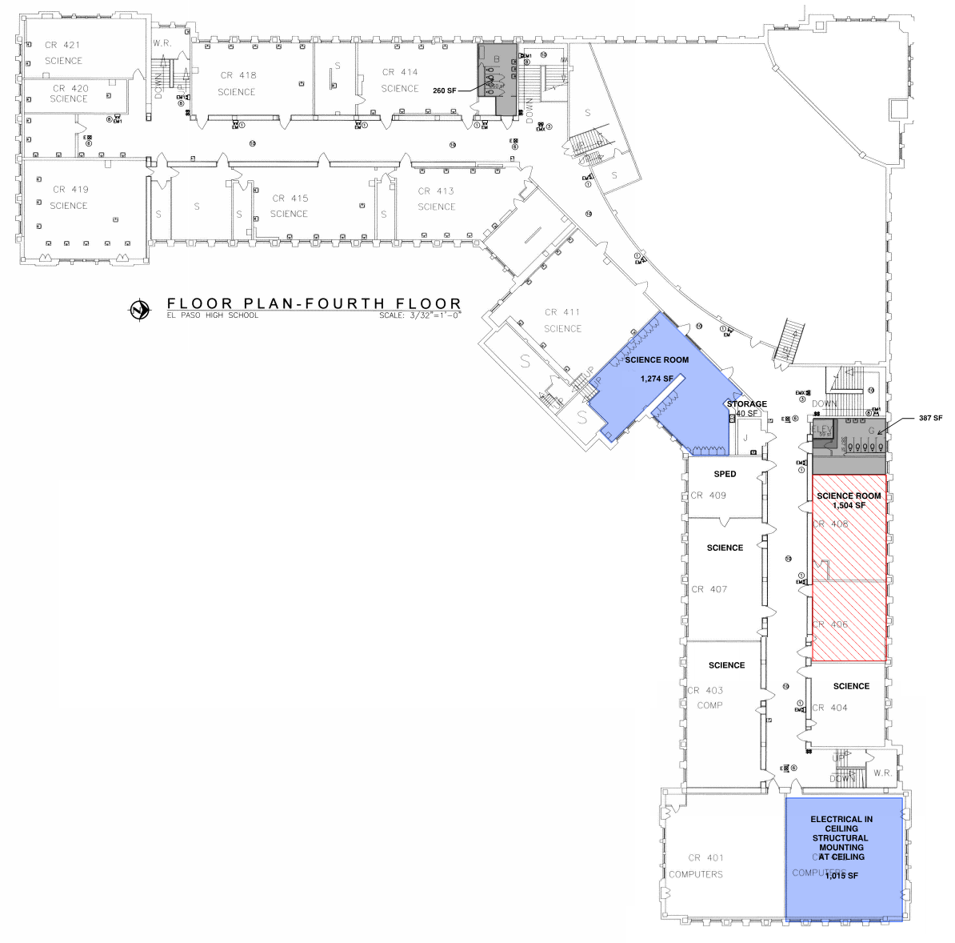
Existing | Fourth Floor
Proposed | Fourth Floor
| Administrative
Alternates

Slide 22
| Administrative
Alternates

Slide 23
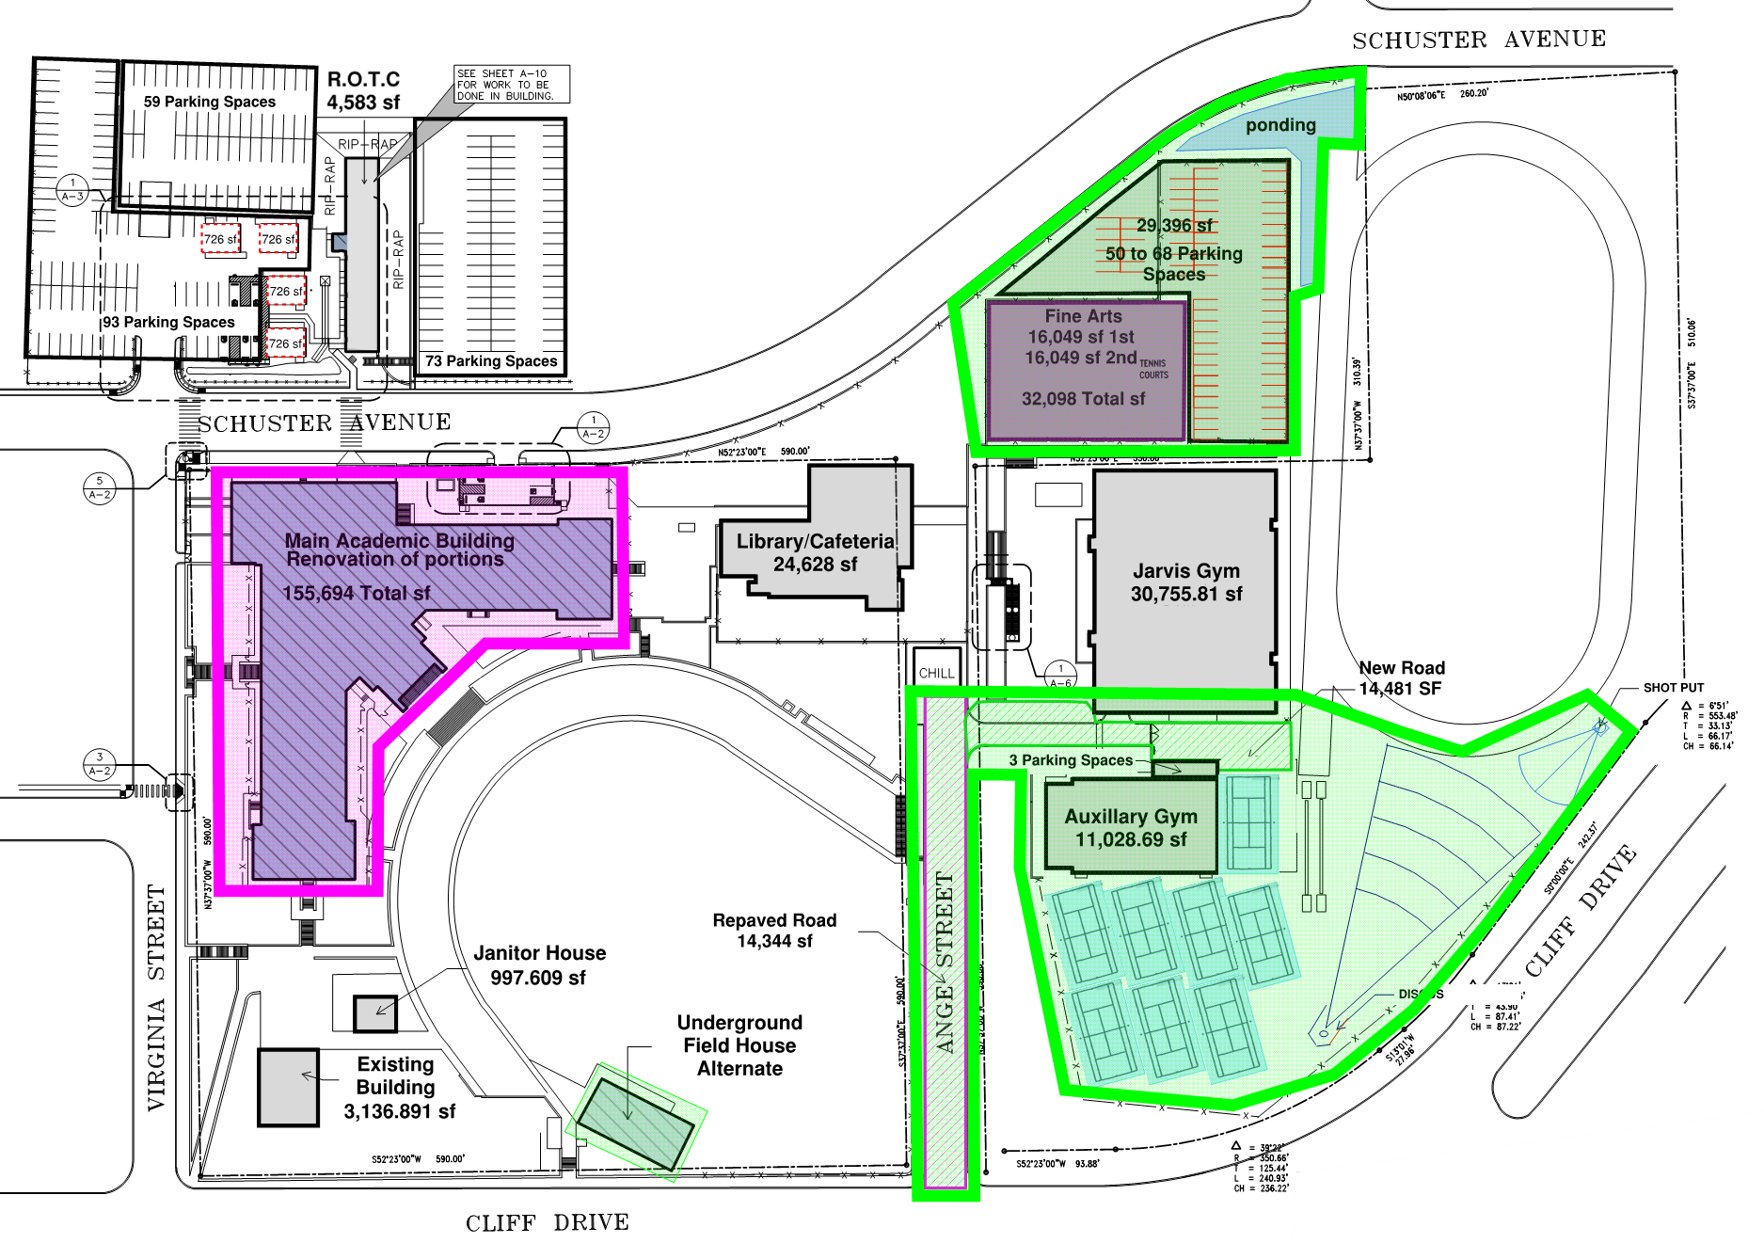
PROPOSED
PHASING
Phase 1 –
Fine Arts Addition + Site
Phase 2 –
Interior Renovations
+

Slide 24
PROGRAM PHASE OVERVIEW
DESIGN | CONSTRUCTION TIMELINE
BUDGET
PHASING : SITE PLANNING + INTERIOR RENOVATIONS
TEAM EXERCISE : METHODOLOGY
TEAM EXERCISE : MATERIALS
NEXT
Q+A
+

Slide 25
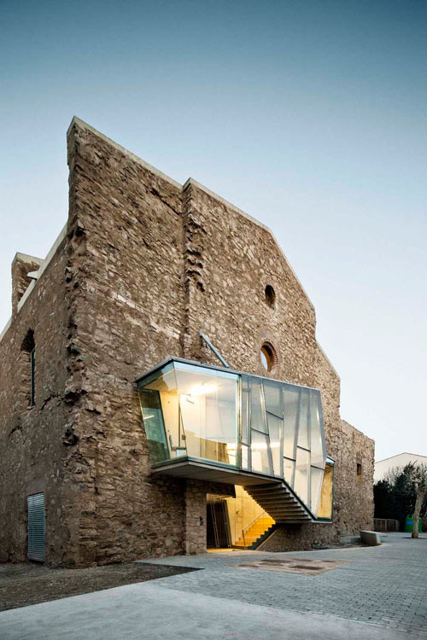
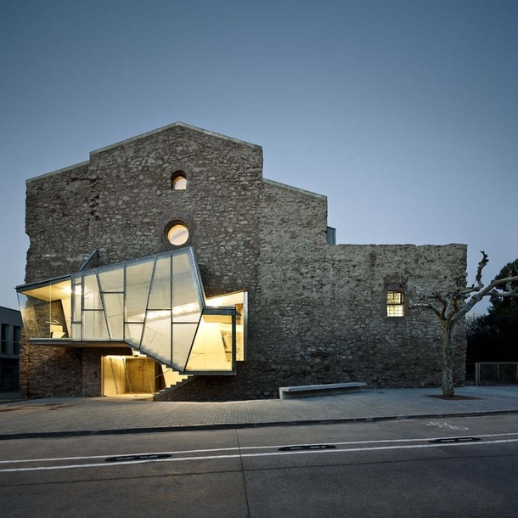
CONTRAST

Slide 26
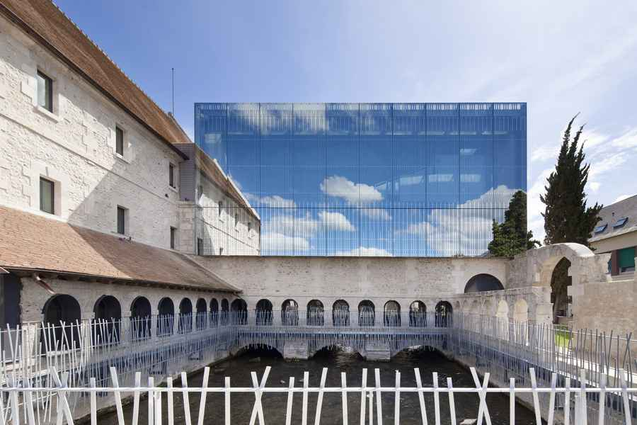
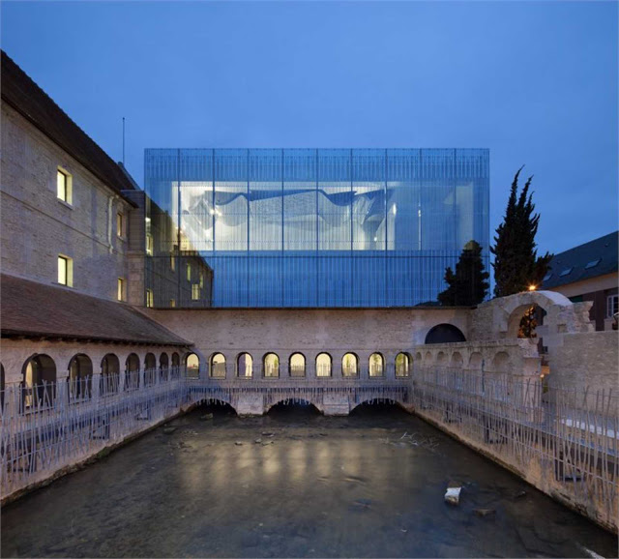
REFLECTION

Slide 27
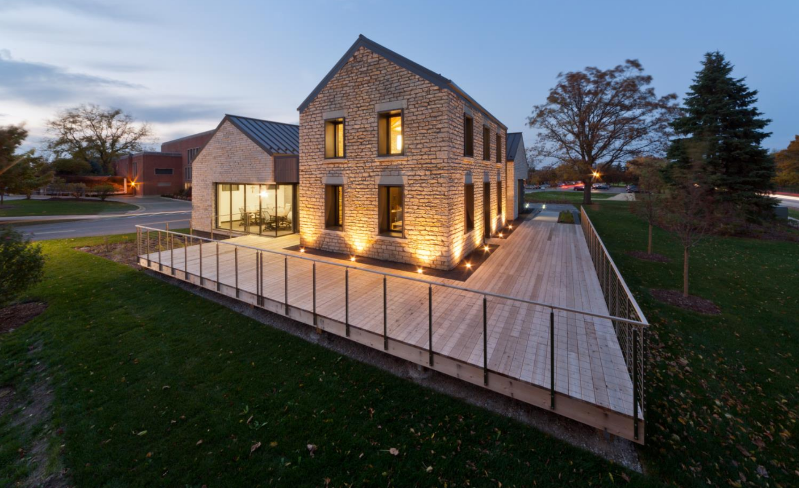
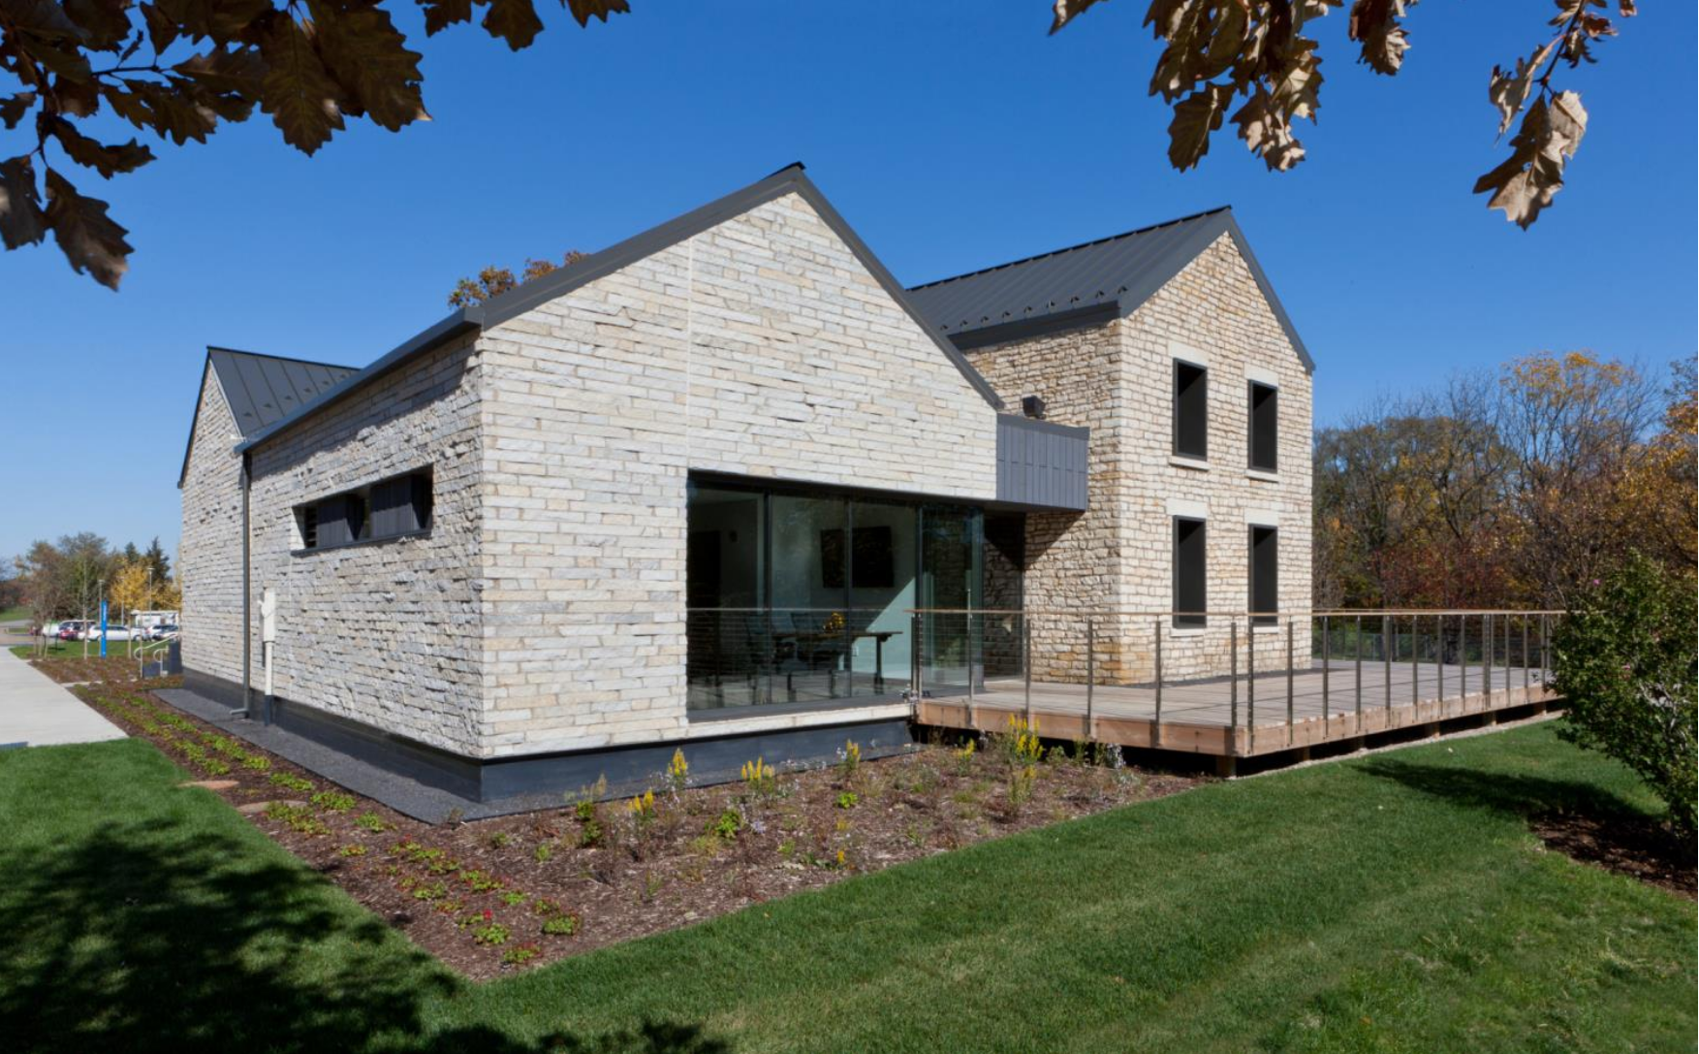
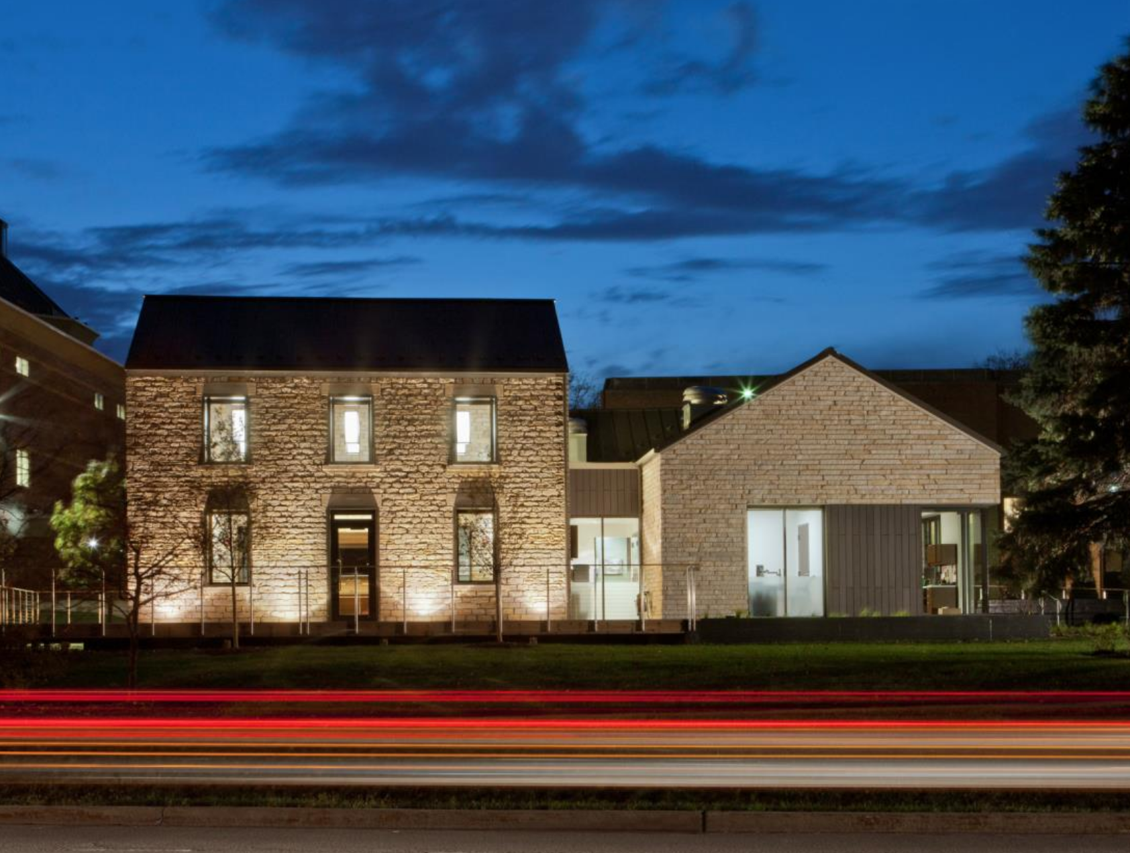
INTEGRATION
INTEGRATION

Slide 28
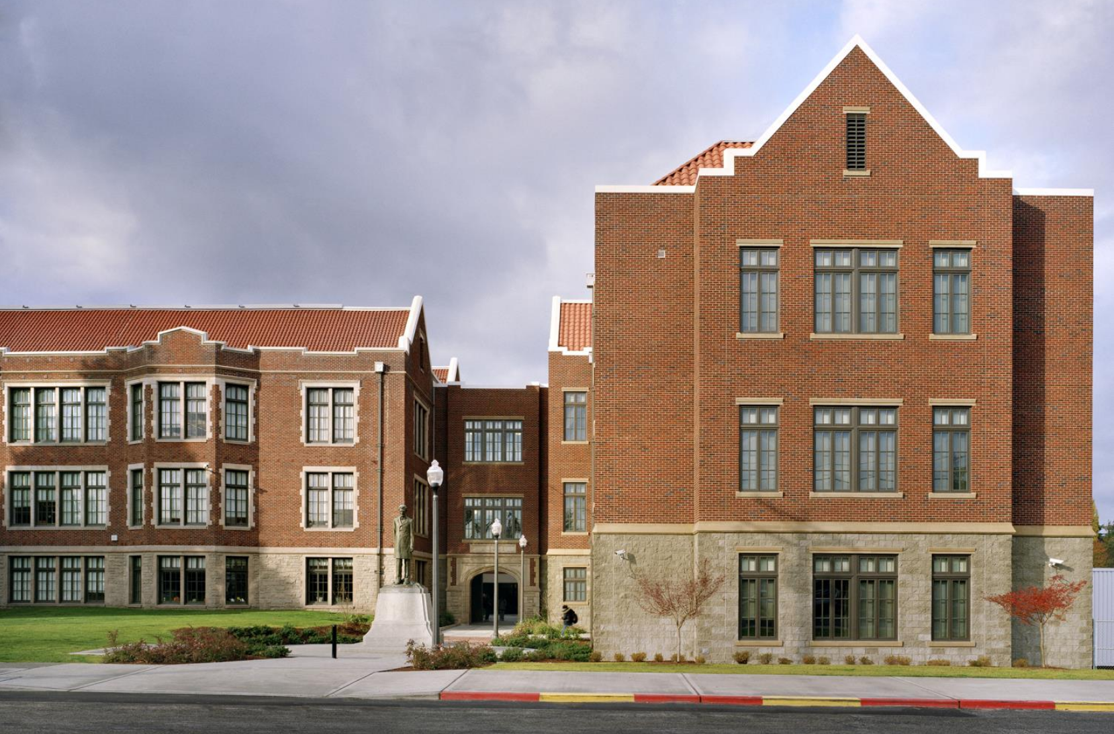
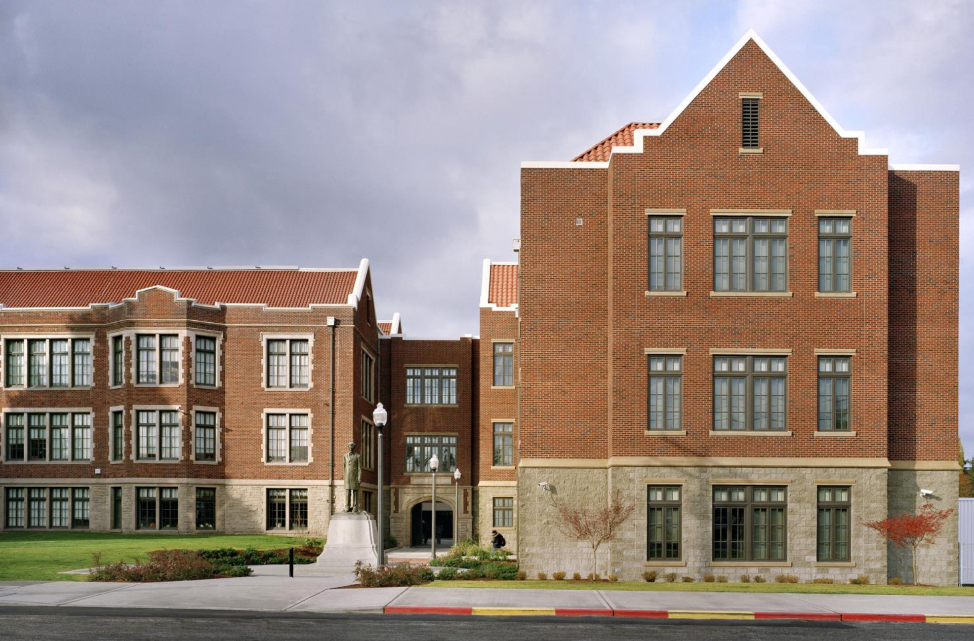
INTEGRATION

Slide 29
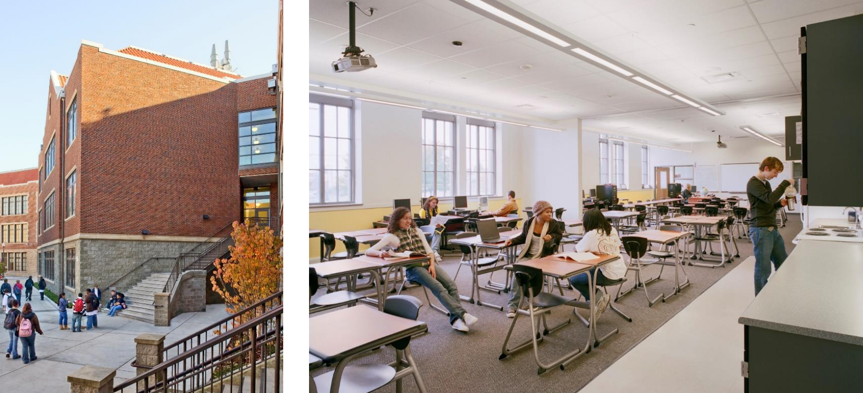

Slide 30
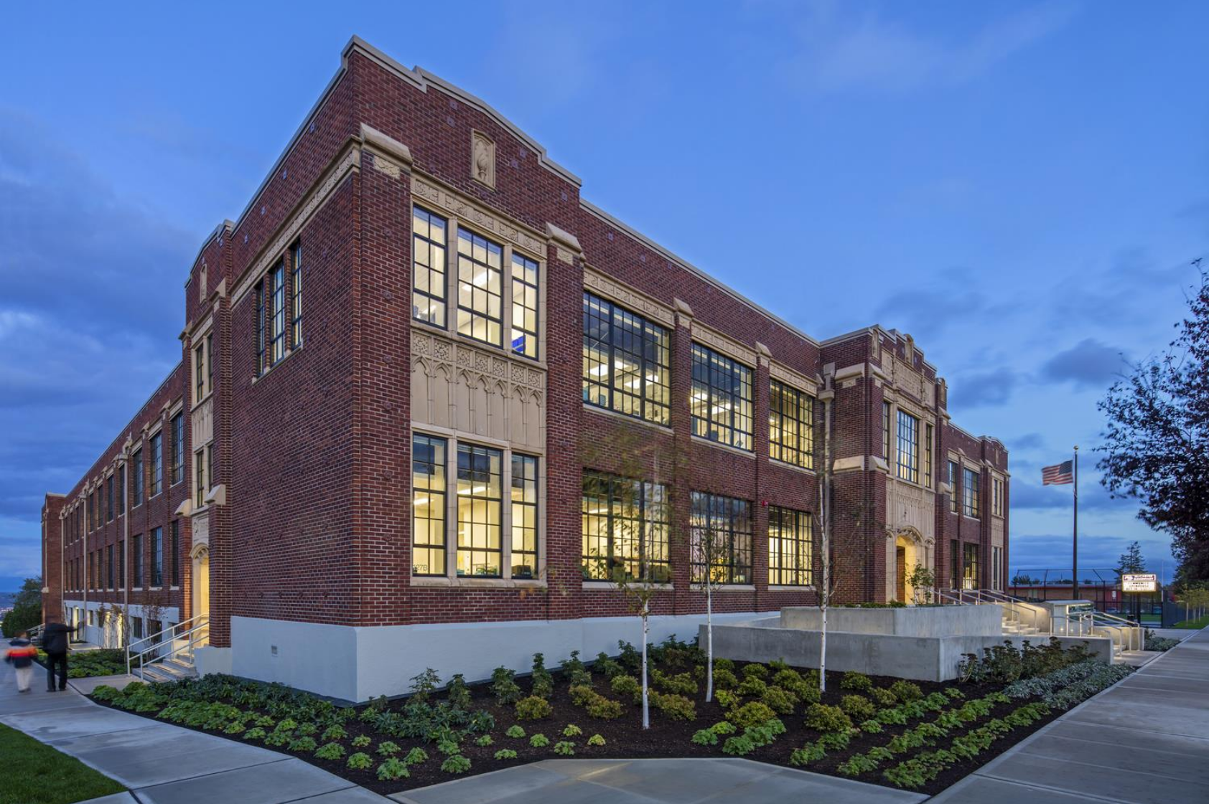
INTEGRATION

Slide 31
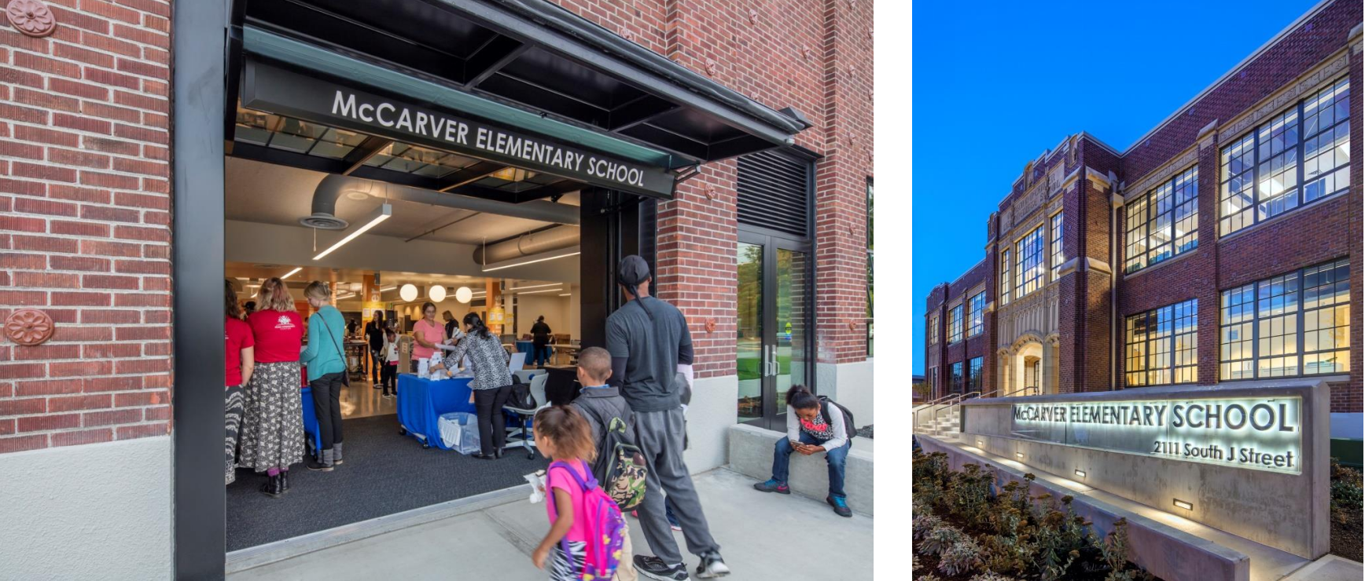

Slide 32
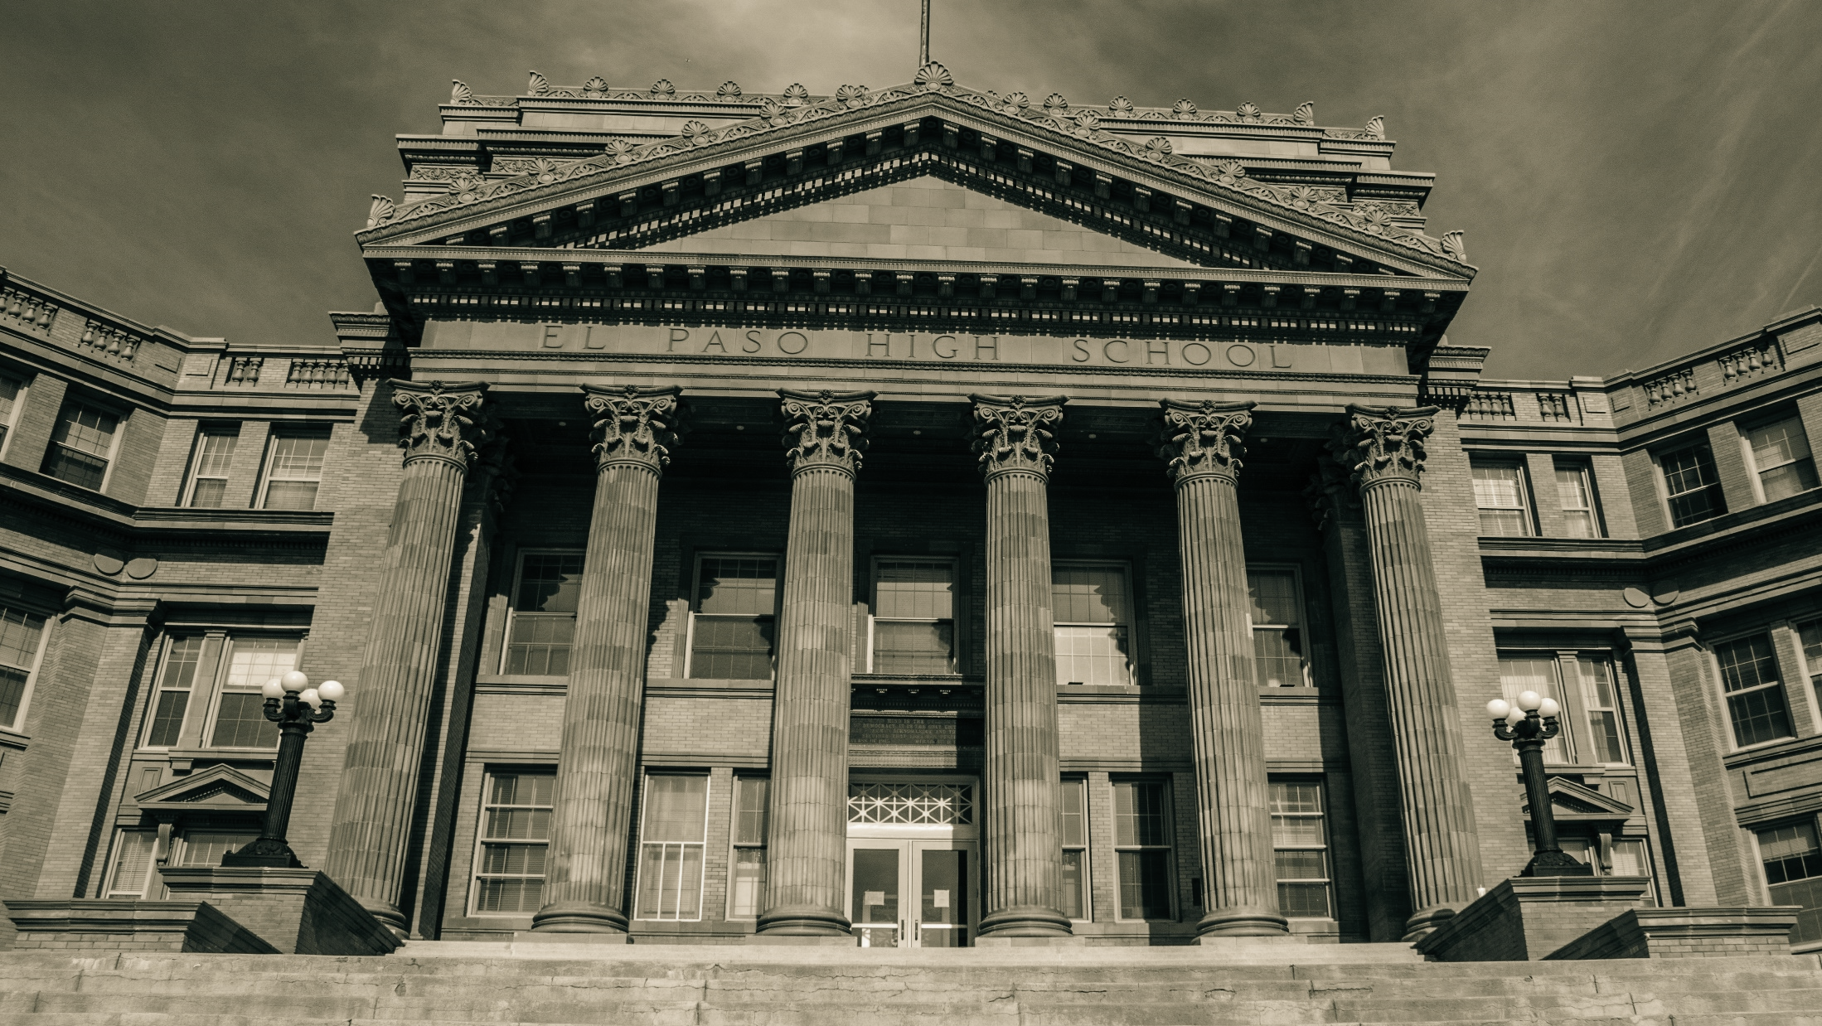

Slide 34
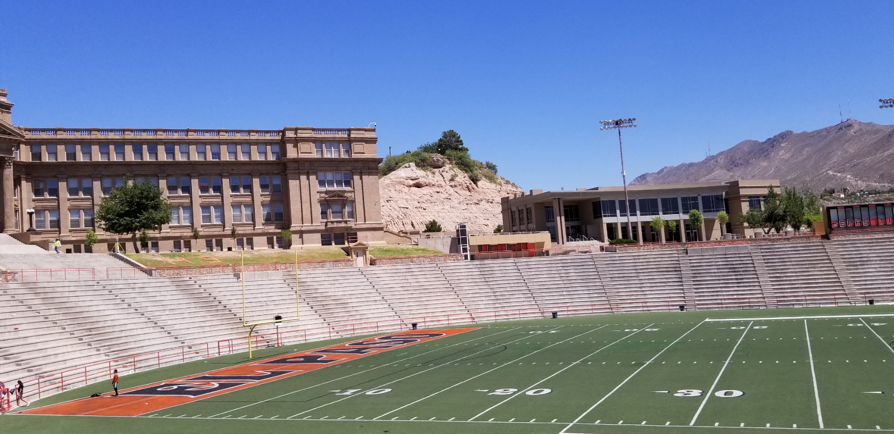

Slide 35
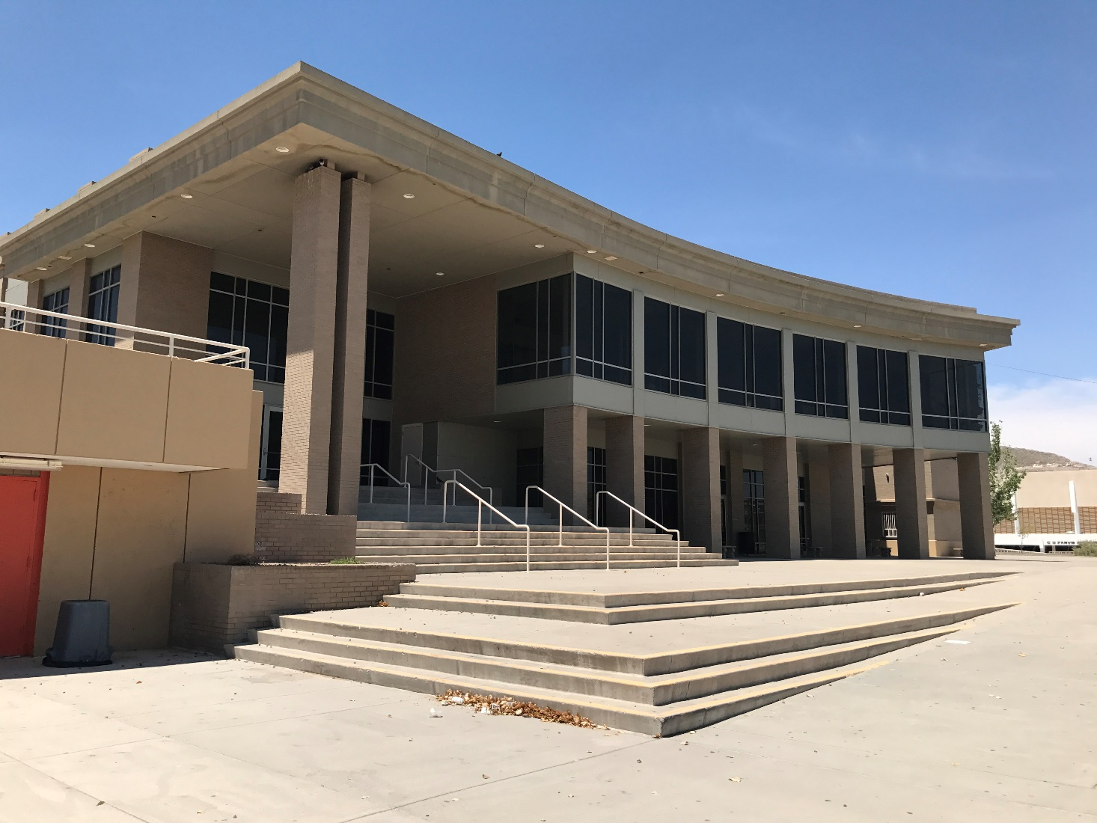

Slide 37
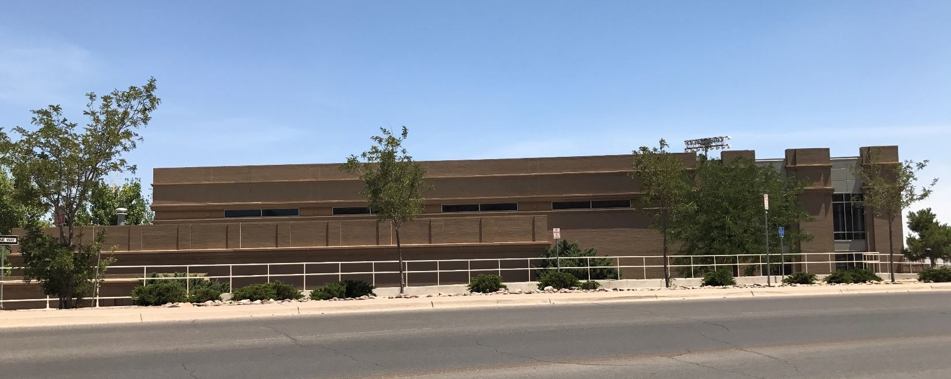

Slide 39
PROGRAM PHASE OVERVIEW
DESIGN | CONSTRUCTION TIMELINE
BUDGET
PHASING : SITE PLANNING + INTERIOR RENOVATIONS
TEAM EXERCISE : METHODOLOGY
TEAM EXERCISE : MATERIALS
NEXT
Q+A
+

Slide 41
PROGRAM PHASE OVERVIEW
DESIGN | CONSTRUCTION TIMELINE
BUDGET
PHASING : SITE PLANNING + INTERIOR RENOVATIONS
TEAM EXERCISE : METHODOLOGY
TEAM EXERCISE : MATERIALS
NEXT
Q + A
+

Slide 42
NEXT
PHASE ONE DEFINING THE VISION
DETAILED
PROGRAMMING
+ BUDGET ALINEMENT
DESIGN
DEVELOPMENT
CONSTRUCTION
DOCUMENTS
SCHEMATIC
DESIGN
+

Slide 43
PROGRAM PHASE OVERVIEW
DESIGN | CONSTRUCTION TIMELINE
BUDGET
PHASING : SITE PLANNING + INTERIOR RENOVATIONS
TEAM EXERCISE : METHODOLOGY
TEAM EXERCISE : MATERIALS
NEXT
Q + A
+

Slide 44
Q + A
+

