Slide 1
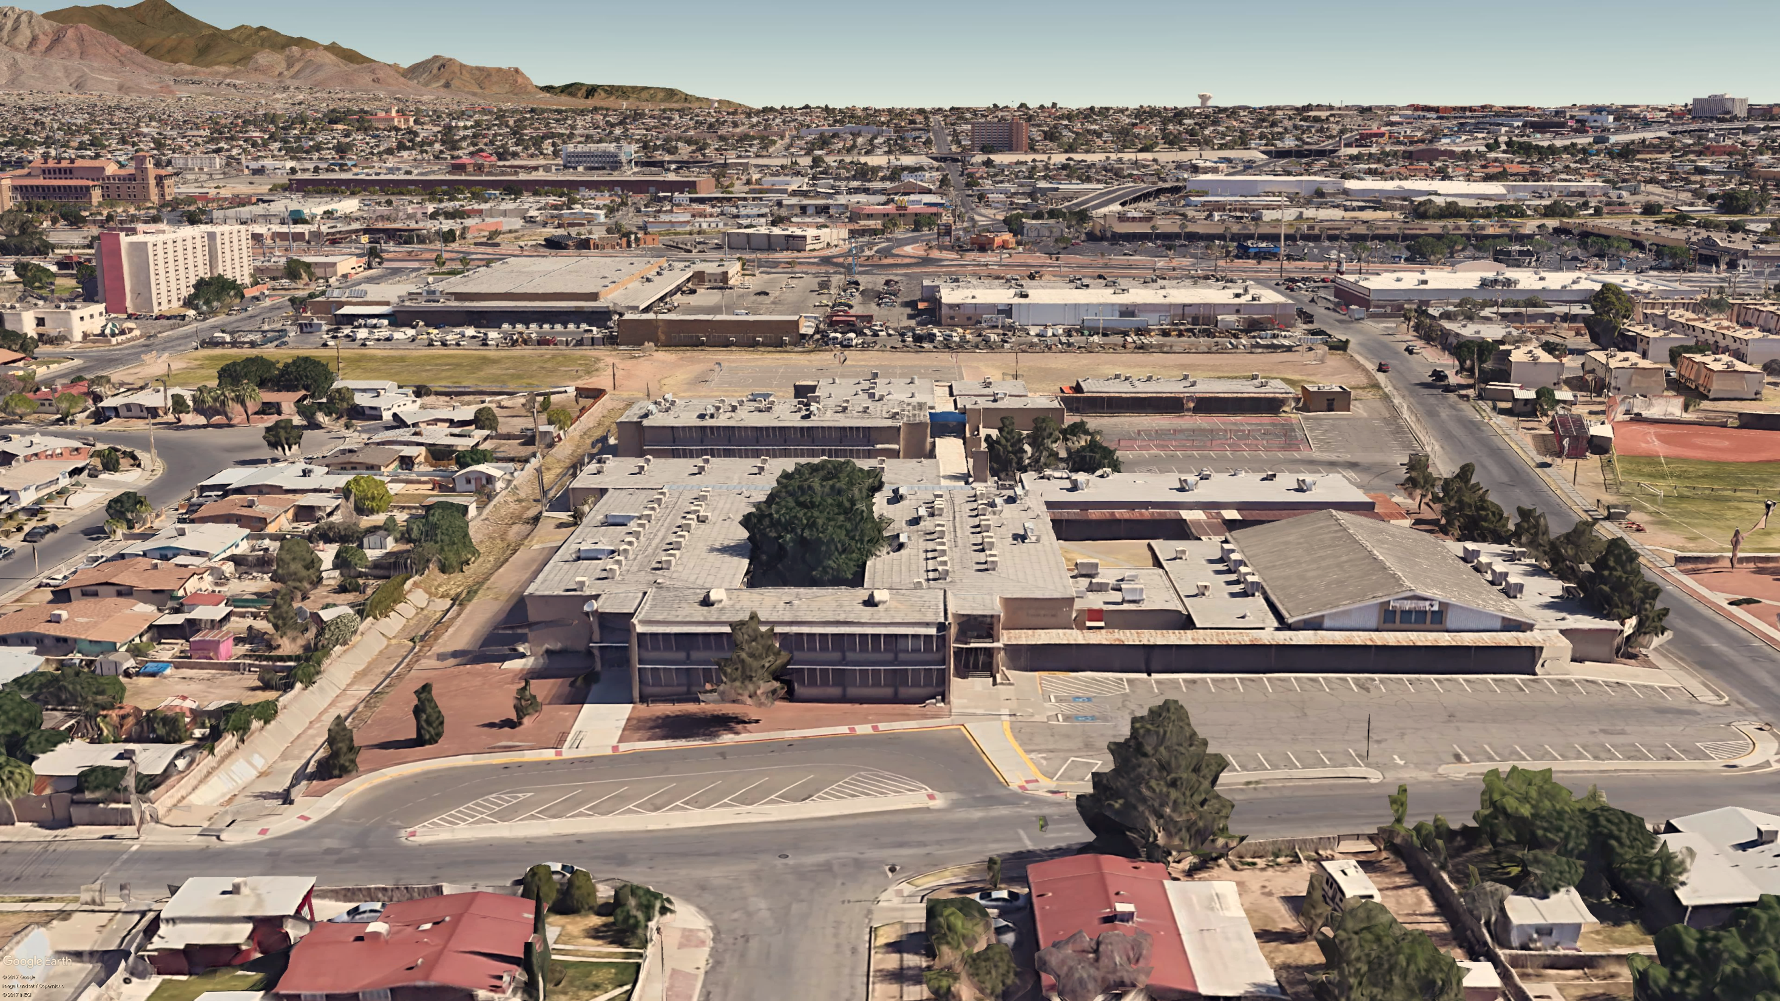
.
.
.
.
.
El Paso Independent School District
Henderson MS Consolidating Clardy ES
EPISD Project No. 17.613
September 26, 2017

Slide 2
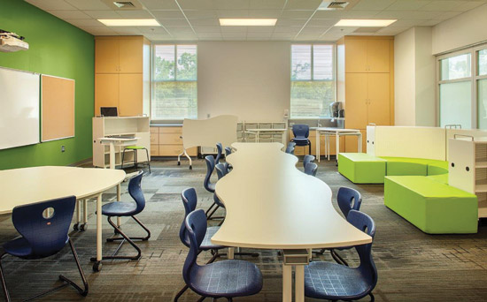
OVERVIEW OF SCHOOL PROGRAM
ELEMENTARY GRADE LEVELS
SPACE | QTY
CLASSROOM FOR 3-year olds | 1
PRE-KINDERGARTEN CLASSROOM | 4
KINDERGARTEN CLASSROOM | 4
PRIMARY CLASSROOM (1) | 4
PRIMARY CLASSROOM (2-3) | 8
INTERMEDIATE CLASSROOM (4) | 3
INTERMEDIATE CLASSROOM (5) | 3
ES ART | 1
ES MUSIC CLASSROOM | 1
ES SCIENCE | 1
COMPUTER LAB | 1
31 CLASSROOMS TOTAL

Slide 3
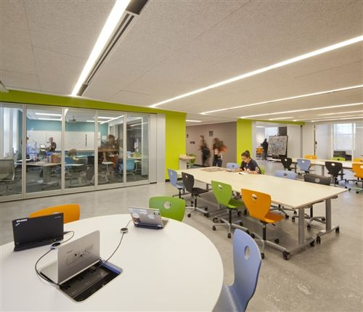
OVERVIEW OF SCHOOL PROGRAM
MIDDLE SCHOOL GRADE LEVELS
SPACE | QTY
ENGLISH / LANGUAGE ARTS | 6
MATH | 6
SOCIAL STUDIES | 2
ESOL | 2
FOREIGN LANGUAGE | 1
SCIENCE LABS | 5
22 GENERAL CLASSROOMS
SPACE | QTY
ART | 1
CHOIR | 1
BAND | 1
ORCHESTRA | 1

Slide 4
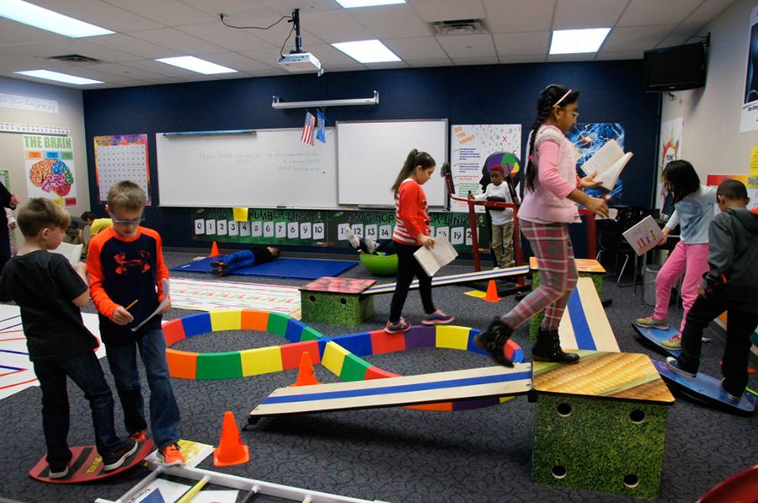
OVERVIEW OF SCHOOL PROGRAM
SPECIAL EDUCATION
SPACE | QTY
SPECIALIZED CLASSROOMS | 2
RESOURCE ROOM | 1
ARD | 1
ACTION-BASED LEARNING LAB | 1
LIFE SKILLS | 2

Slide 5
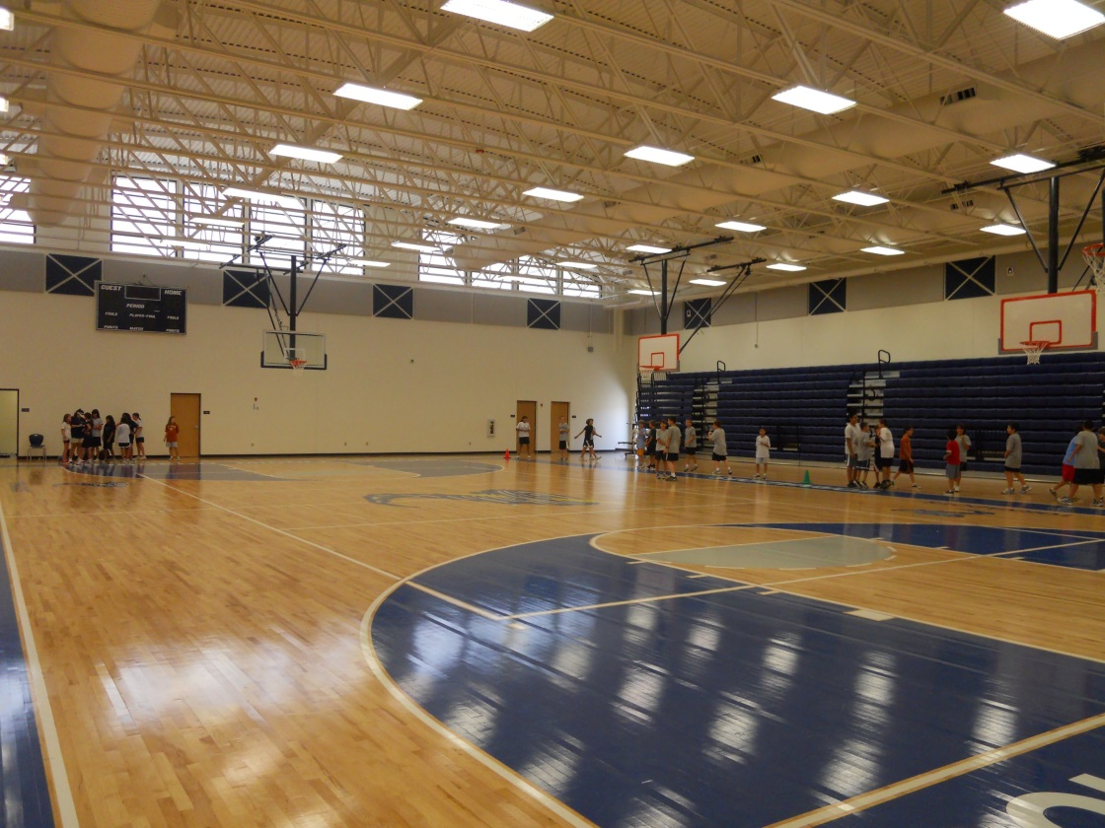
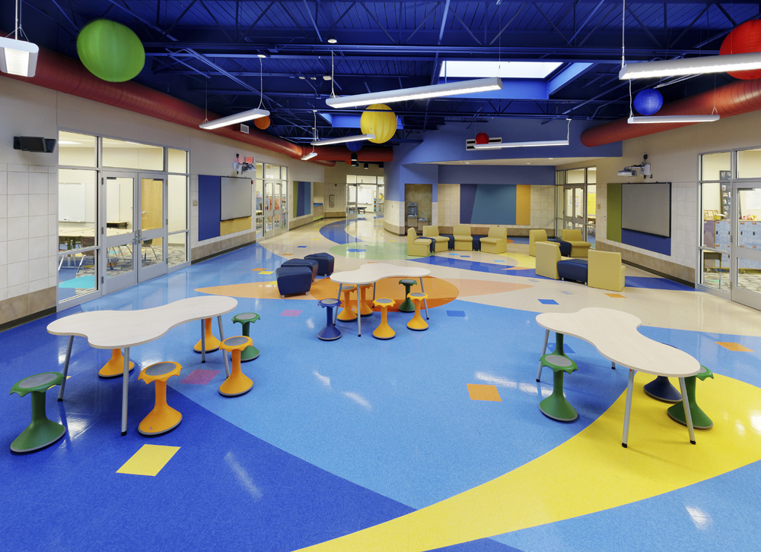
OVERVIEW OF SCHOOL PROGRAM
PHYSICAL EDUCATION
SPACE | QTY
ES MULTI-PURPOSE | 1
MS GYMNASIUM | 1
LOCKER ROOMS (MALE) | 1
LOCKER ROOMS (FEMALE) | 1

Slide 6
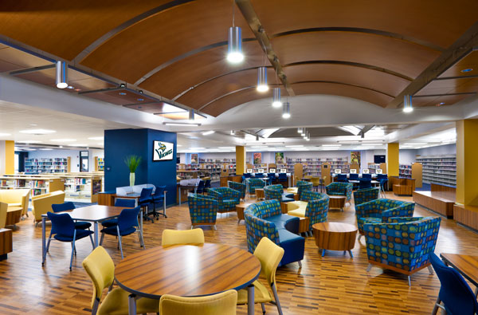
OVERVIEW OF SCHOOL PROGRAM
MEDIA CENTER
SPACE | QTY
LIBRARY | 1
PROFESSIONAL LIBRARY | 1
CONFERENCE ROOM | 1
VIDEO / CCTV / MEDIA PRODUCTION | 1

Slide 7
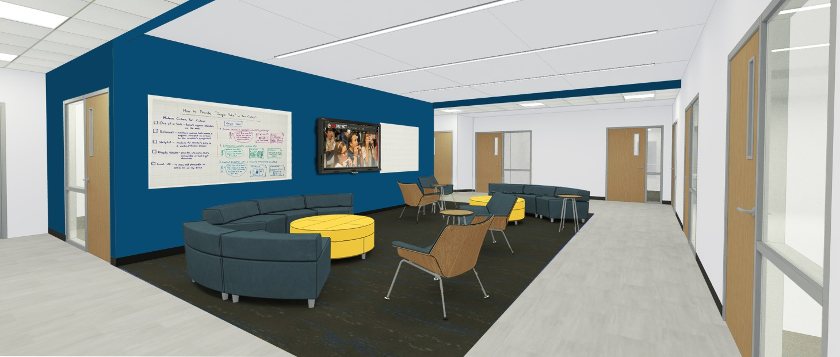
OVERVIEW OF SCHOOL PROGRAM
ADMINISTRATION
SPACE | QTY
RECEPTION | 1
PRINCIPALS OFFICE | 1
ASSISTANT PRINCIPALS OFFICE | 3
WORKROOMS | 4
CLINIC | 1
SPEECH / DIAGNOSTICIAN | 2
COUNSELOR SUITE | 1
STUDENT ACTIVITIES AREA | 1
TEACHER LOUNGES | 2
TEACHER COLLABORATION
PARENT MEETINGS

Slide 8
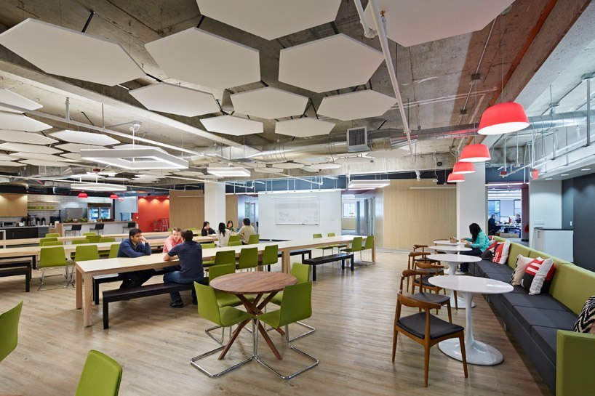
OVERVIEW OF SCHOOL PROGRAM
FOOD SERVICE
SPACE | QTY
DINING AREA | 1
KITCHEN | 1

Slide 9
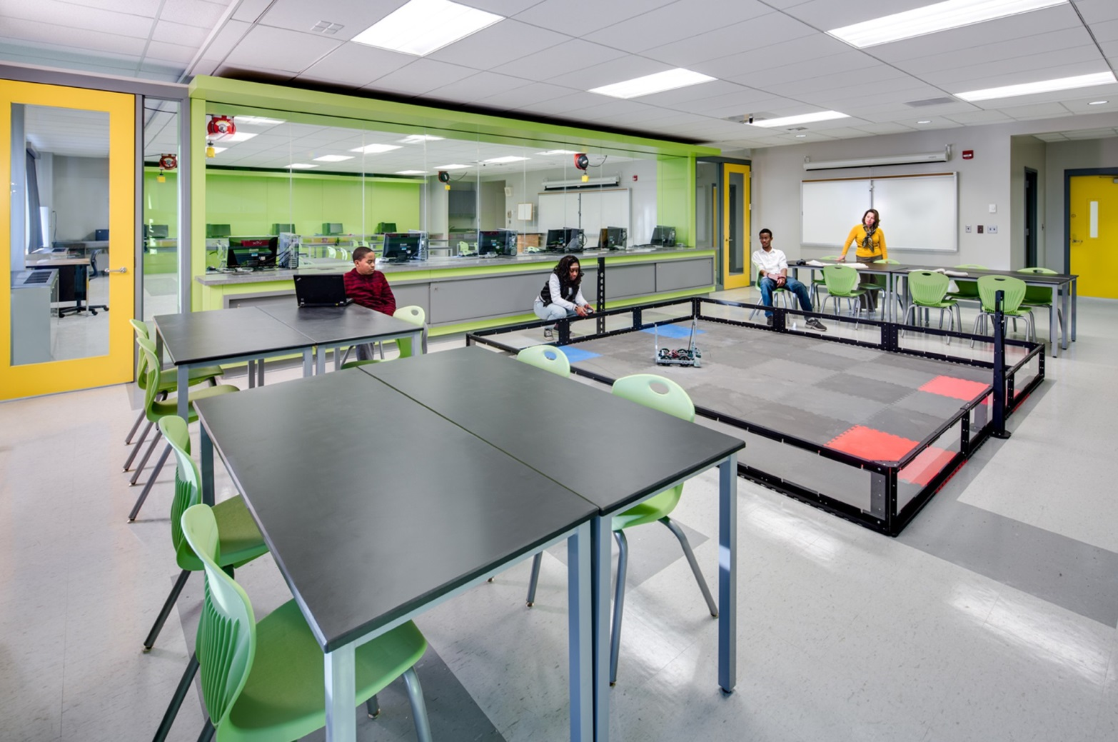
OVERVIEW OF SCHOOL PROGRAM
CAREER AND TECHNOLOGY
SPACE | QTY
MS COMPUTER LAB | 1
ES COMPUTER LAB | 1
ROBOTICS CLASSROOM / LAB | 1

Slide 10
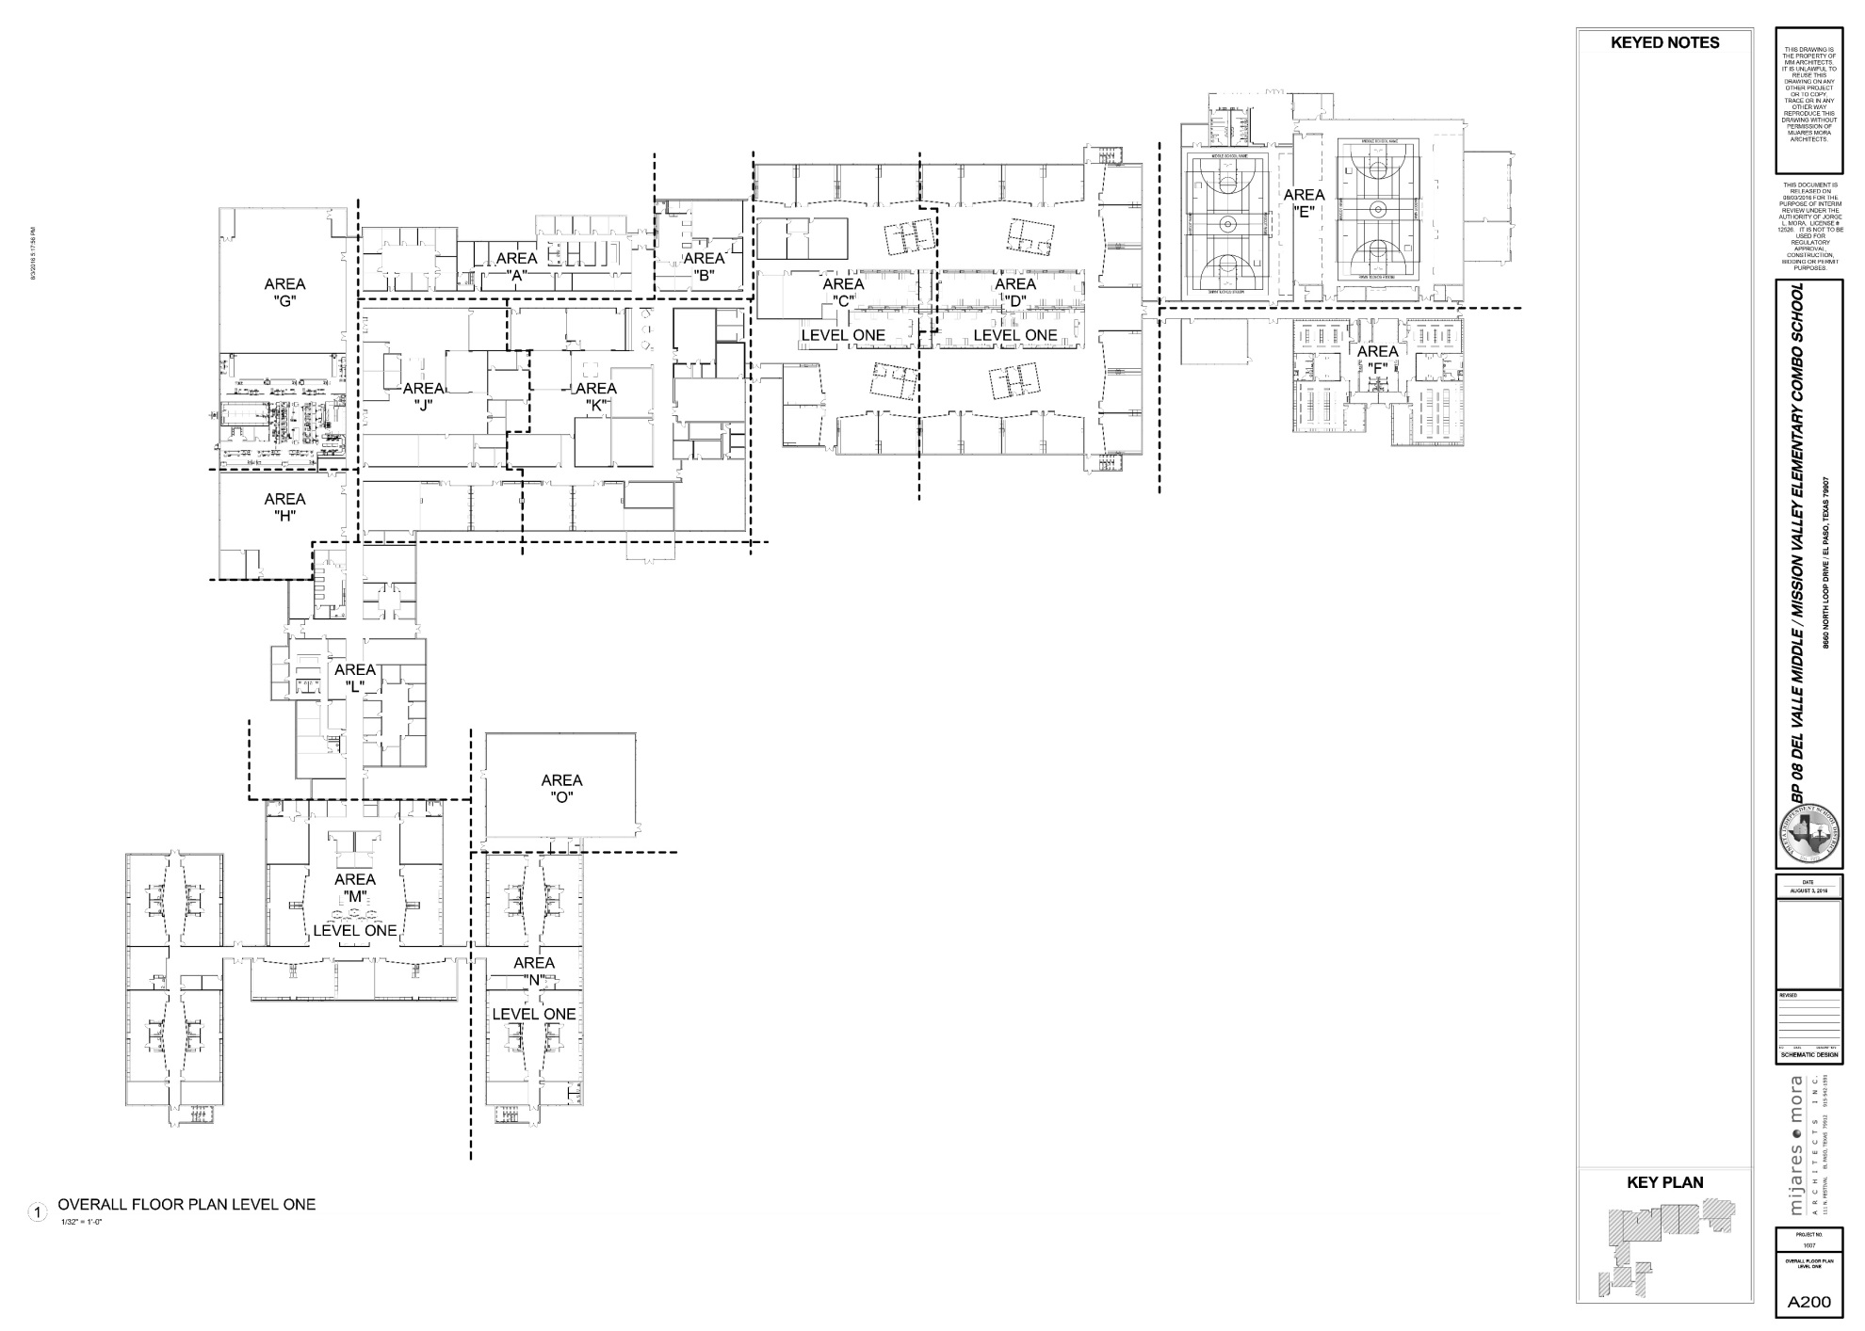
DESIGN / CONSTRUCTION TIMELINE
SCHEMATIC DESIGN
NOVEMBER 2017
CODE ANALYSIS
COMMUNITY INPUT
DESIGN CONCEPTS
ESTABLISHING SPATIAL HIERARCHY; GENERAL SCOPE
ESTABLISH SCALE AND RELATIONSHIPS BETWEEN BUILDING SYSTEMS AND ELEMENTS
DESIGN TEAM EXPLORES OPTIONS FOR ALL SYSTEMS (STRUCTURAL, MECHANICAL, ELECTRICAL, PLUMBING, FOOD SERVICE)
COST ESTIMATE

Slide 11
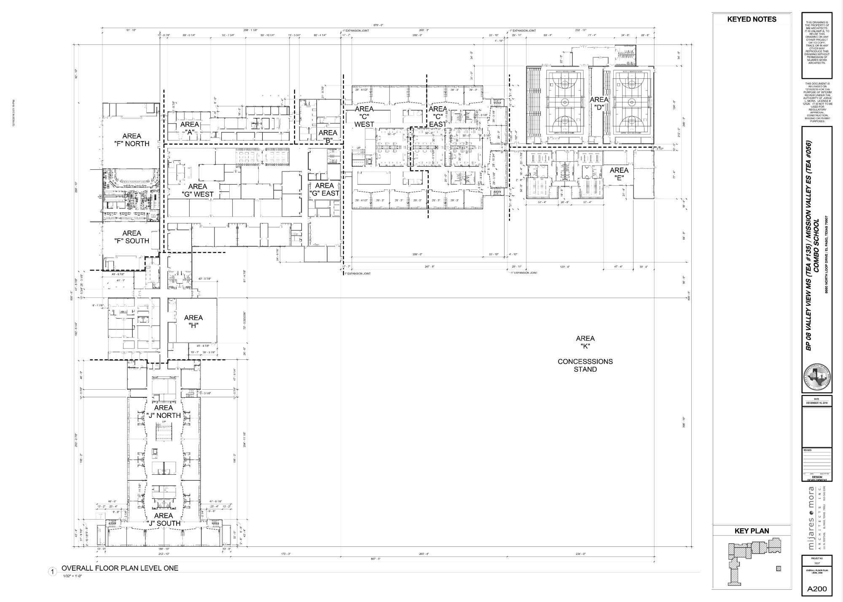
DESIGN / CONSTRUCTION TIMELINE
DESIGN DEVELOPMENT
DECEMBER 2017
CODE ANALYSIS
DEVELOP SELECTED DESIGN CONCEPT
SELECT FINISH MATERIALS FOR INTERIOR AND EXTERIOR
DEVELOP BUILDING SYSTEMS
OUTLINE SPECIFICATIONS OF BUILDING COMPONENTS
COST ESTIMATE

Slide 12
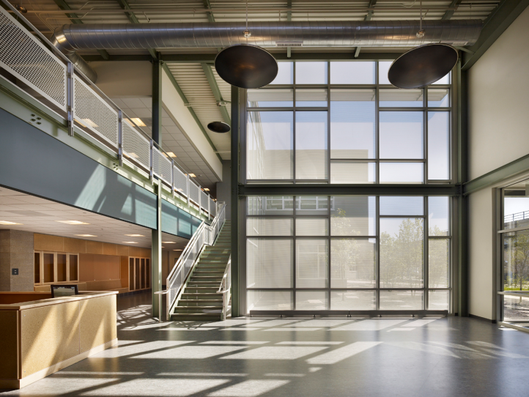
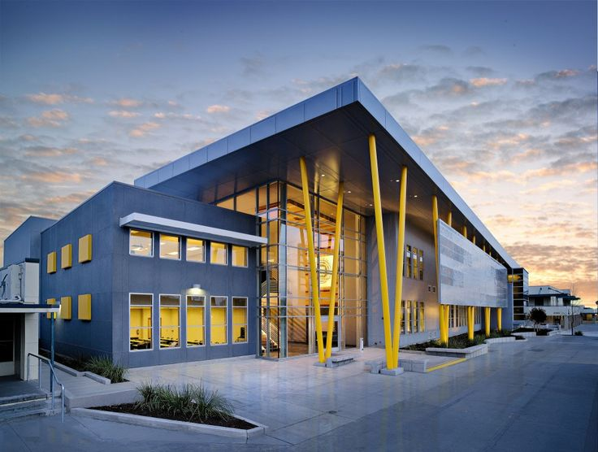
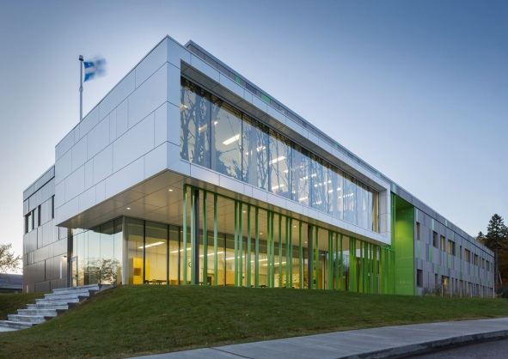
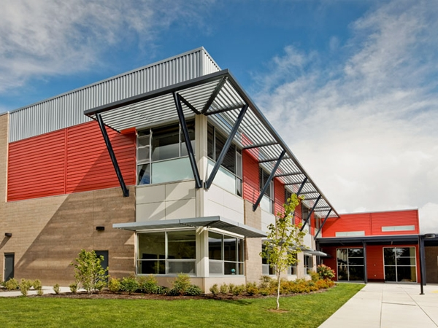
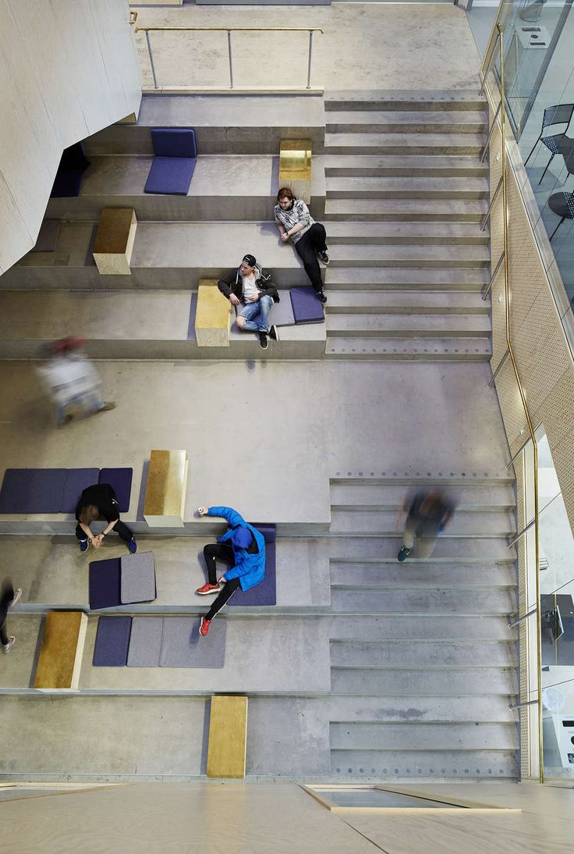
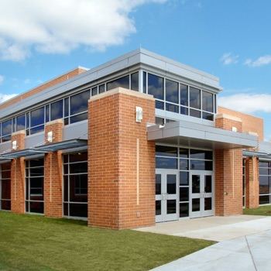
DESIGN / CONSTRUCTION TIMELINE
DESIGN DEVELOPMENT material selection

Slide 13
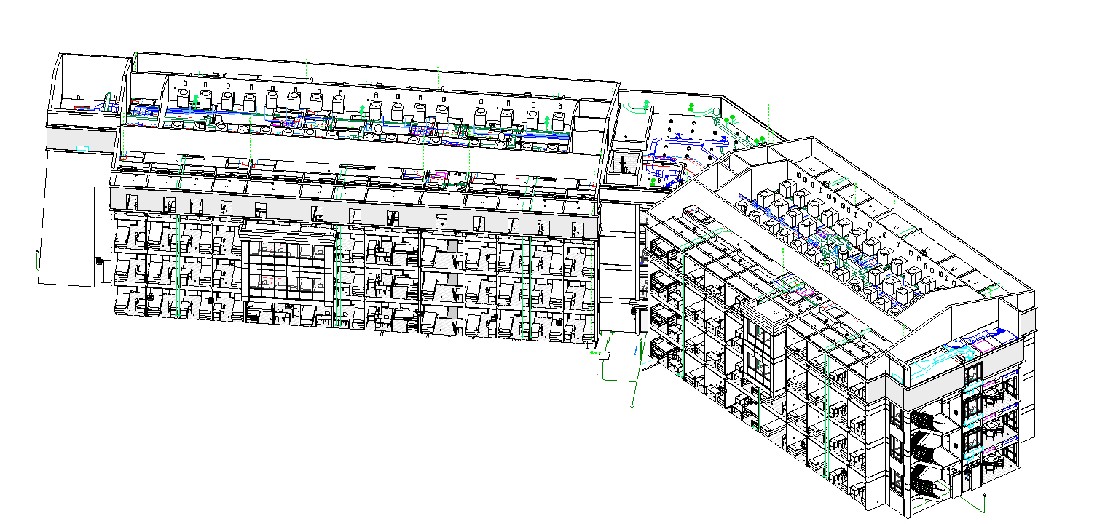
DESIGN / CONSTRUCTION TIMELINE
CONSTRUCTION DOCUMENTS
MAY 2018
CODE ANALYSIS
DEVELOP DESIGN AND BUILDING DETAILS (set of instructions for contractor)
INDICATE BUILDING SYSTEMS AS A WHOLE
SELECT FINAL FINISHES
TECHNICAL SPECIFICATIONS OF BUILDING COMPONENTS
COST ESTIMATE

Slide 14
DESIGN / CONSTRUCTION TIMELINE
CONSTRUCTION
AUGUST 2018 – JANUARY 2021
WEEKLY OWNER, ARCHITECT, CONTRACTOR MEETINGS TO MAINTAIN SCHEDULE
REVIEW CONTRACTOR INQUIRIES (REQUESTS FOR INFORMATION)
REVIEW SUBMITTAL OF SPECIFIED COMPONENTS TO ENSURE THEY MEET EPISD STANDARDS AND REQUIREMENTS
REVIEW CONSTRUCTION PROGRESS FOR CONFORMANCE WITH CONSTRUCTION DOCUMENTS
OWNER PROVIDES INPUT FOR UPCOMING SCHOOL EVENTS FOR CONTRACTOR SCHEDULE COORDINATION
UNDER CONSTRUCTION
This Photo by Unknown Author is licensed under CC BY-SA

Slide 15
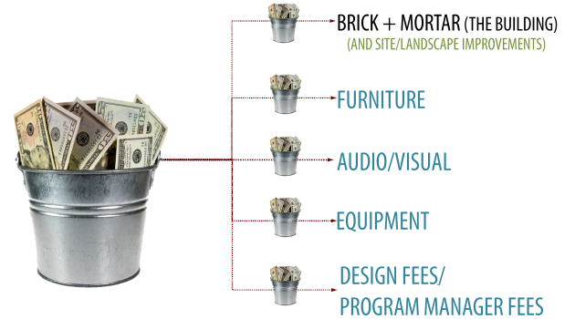
BUDGET
$30,200,000.00
TOTAL PROJECT COSTS
$39,118,352.00

Slide 16
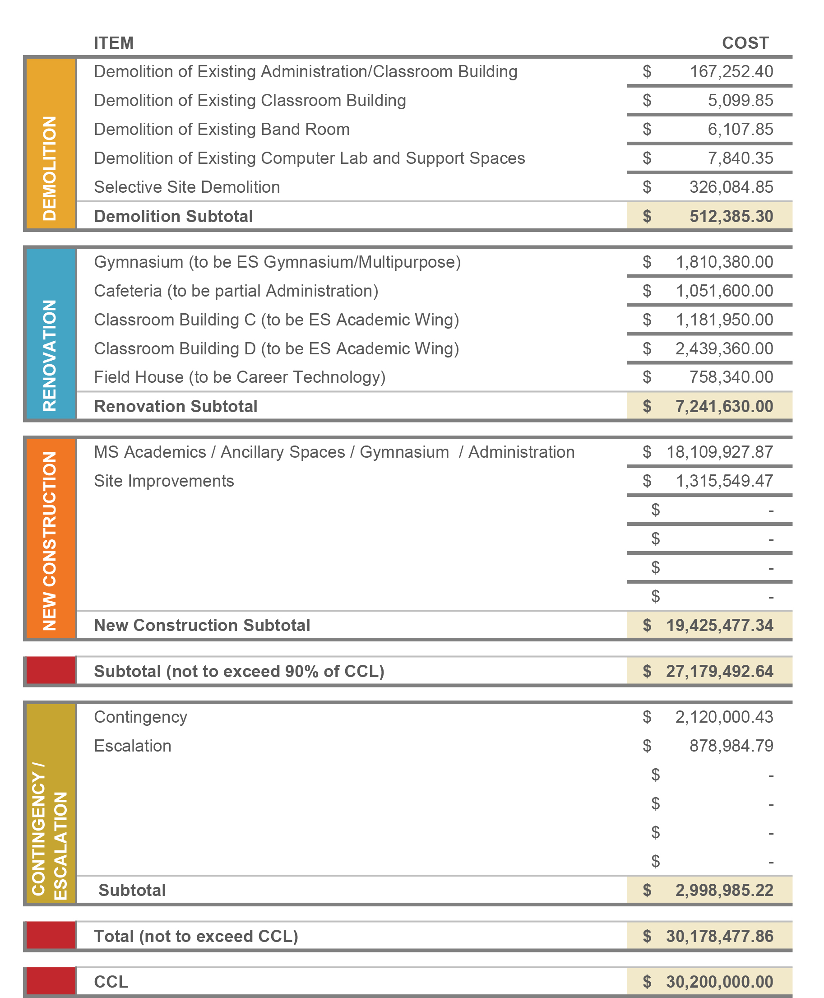
BUDGET

Slide 17
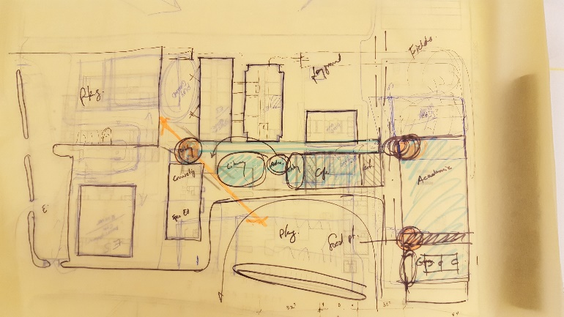
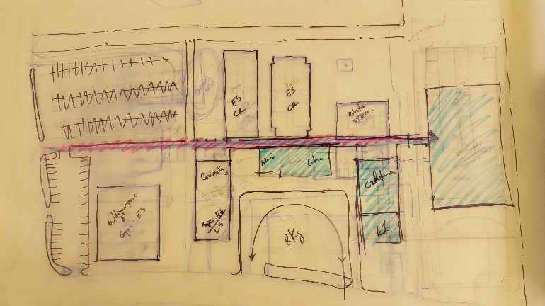
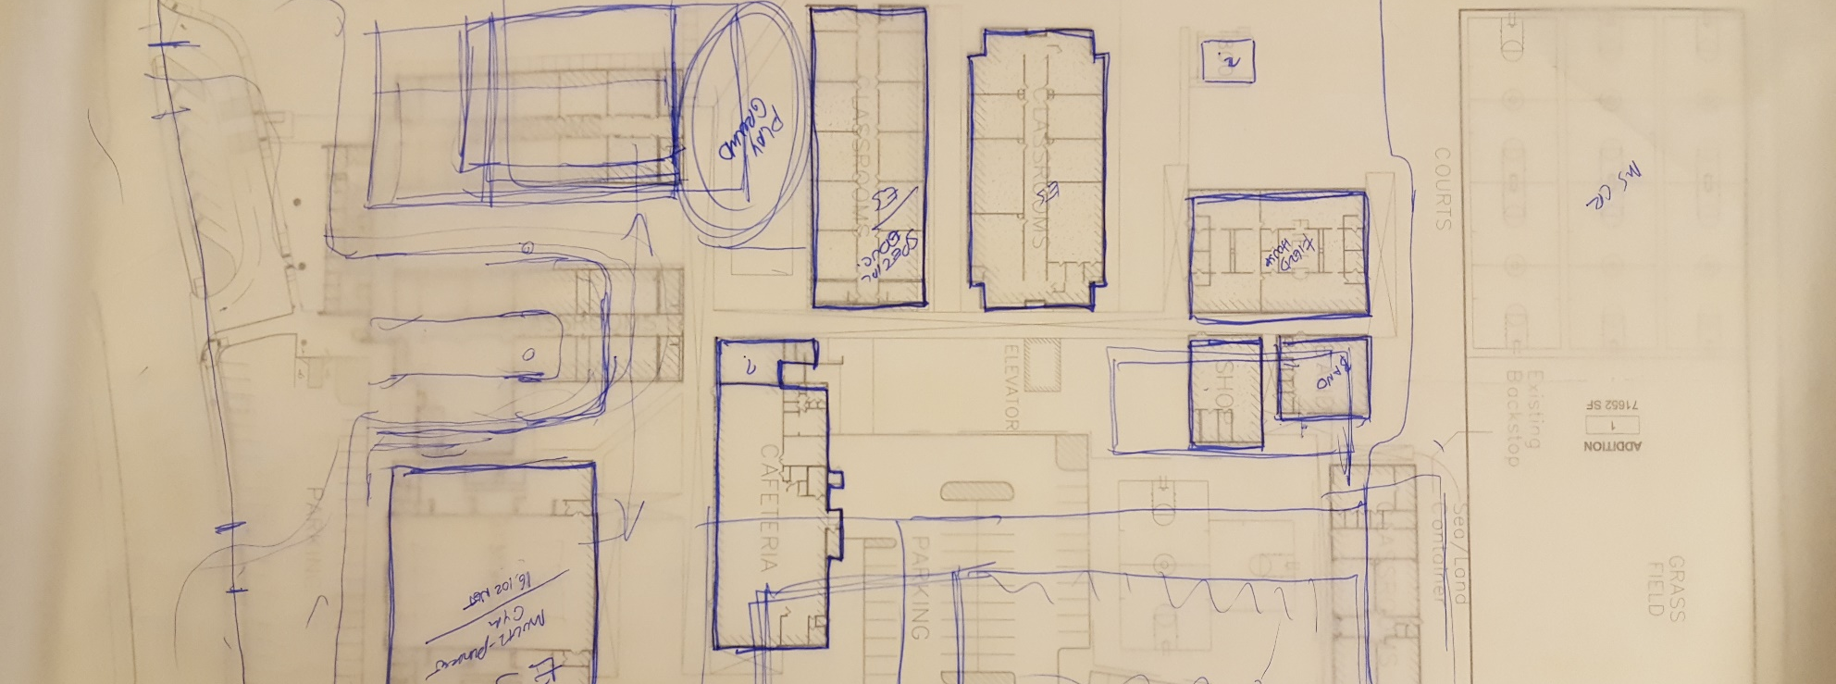
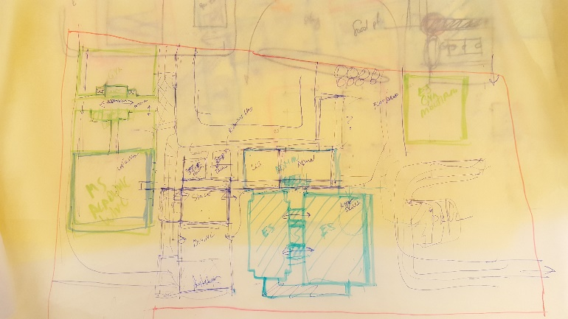
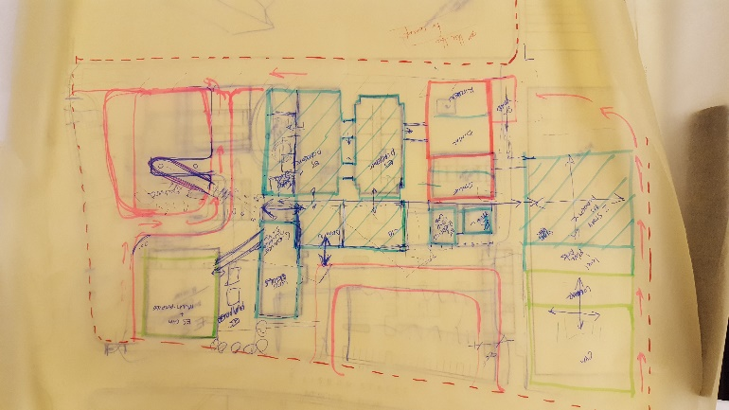
Conceptual Plan

Slide 18
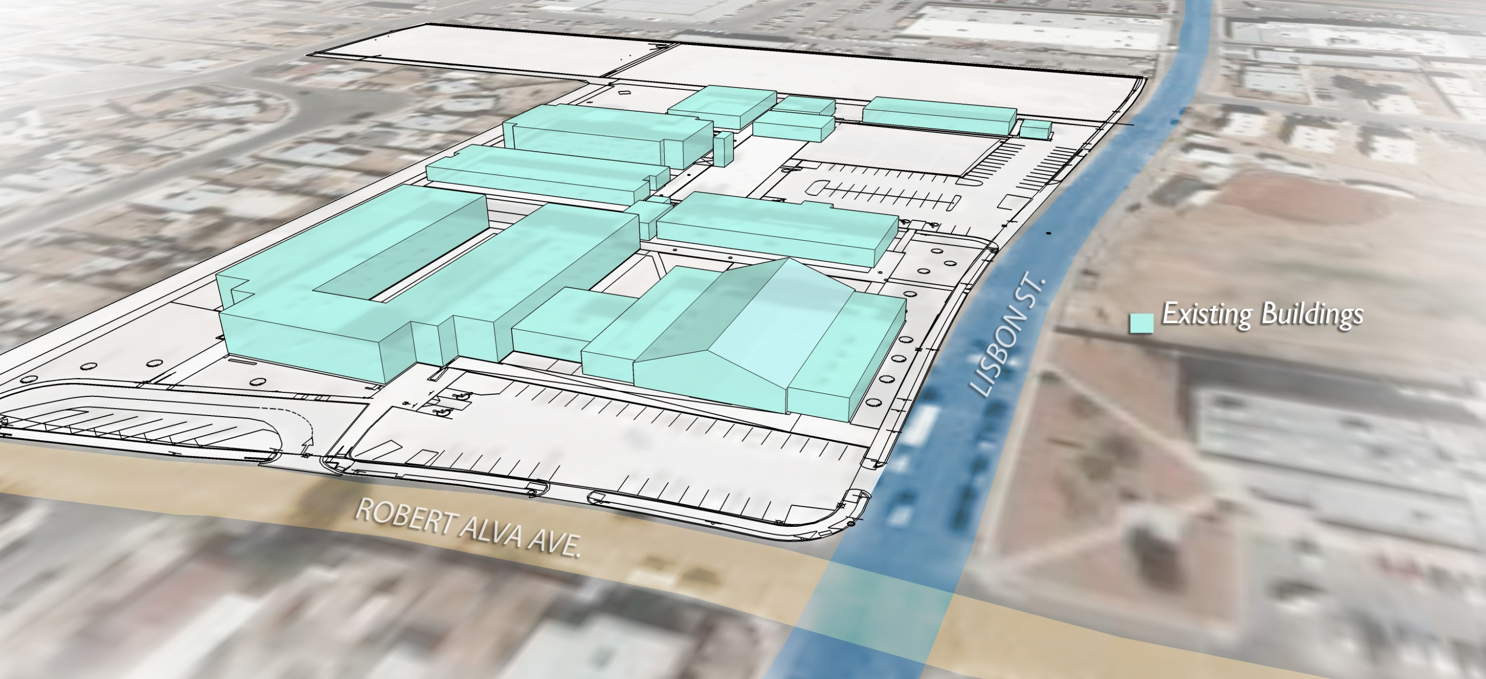
Existing Buildings

Slide 19
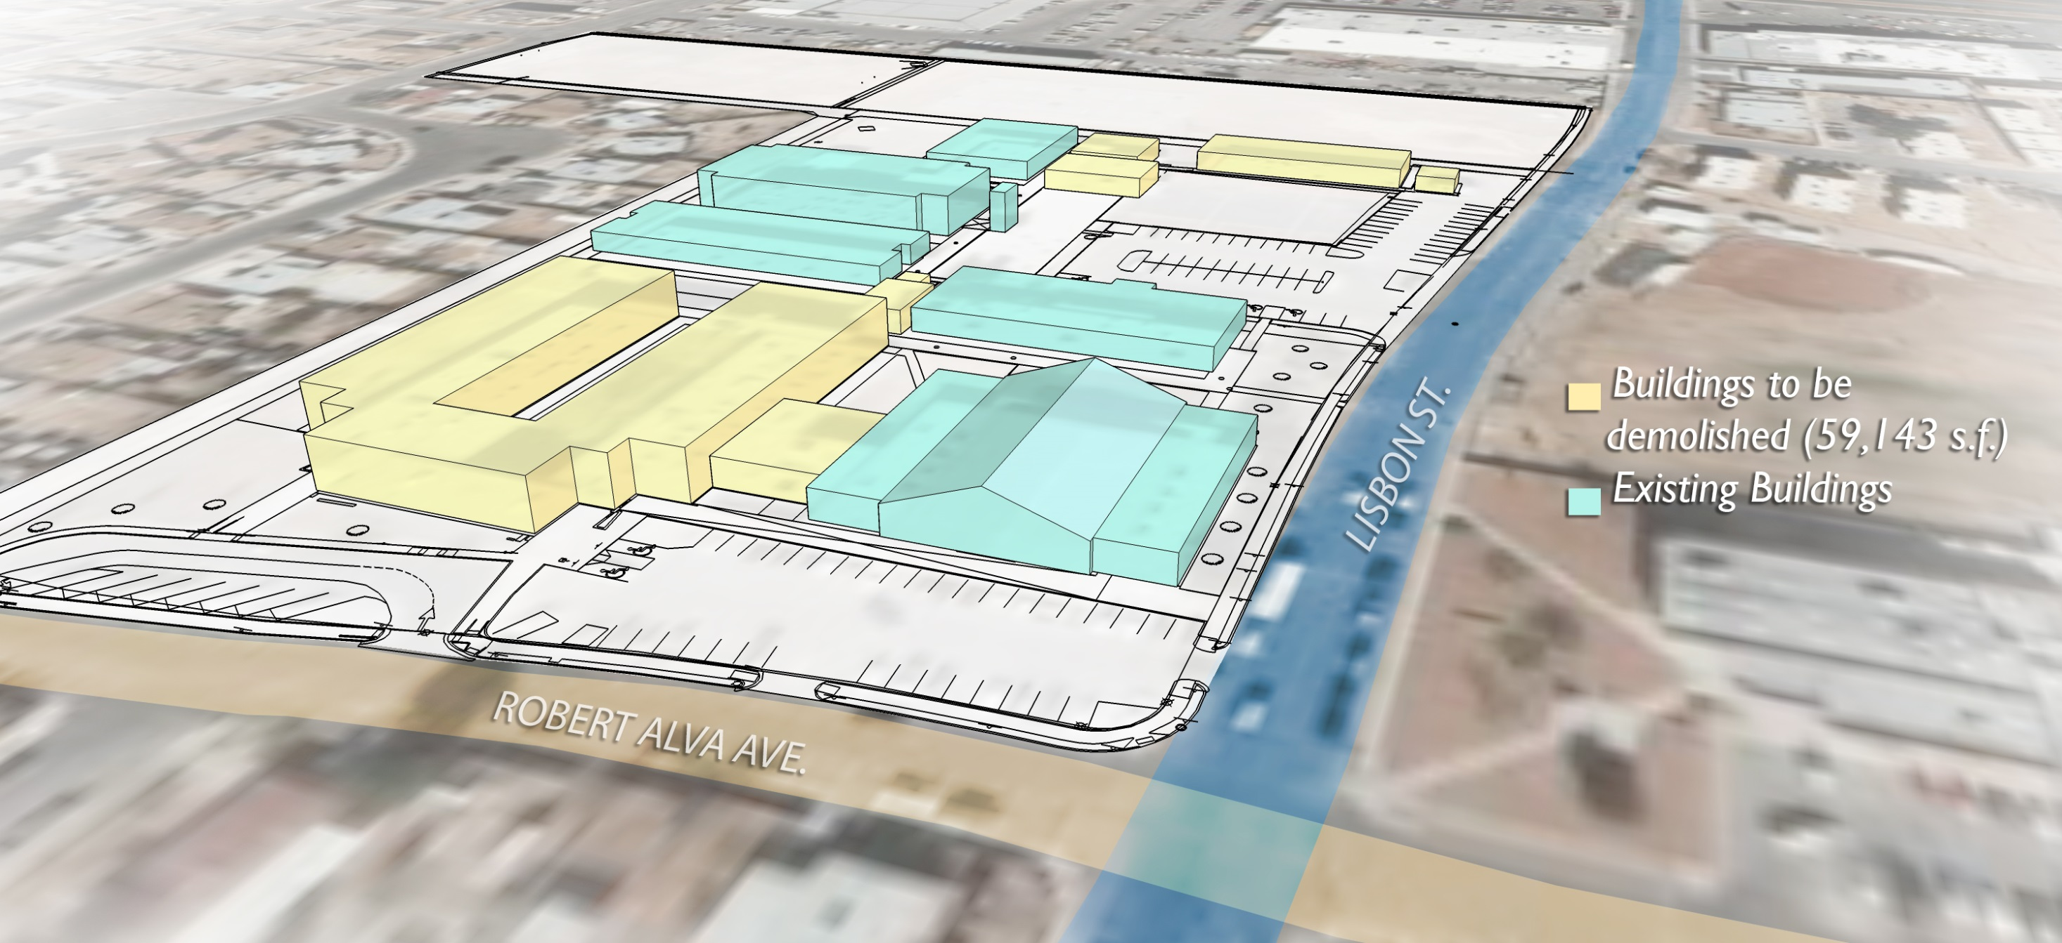
Buildings to be Demolished

Slide 20
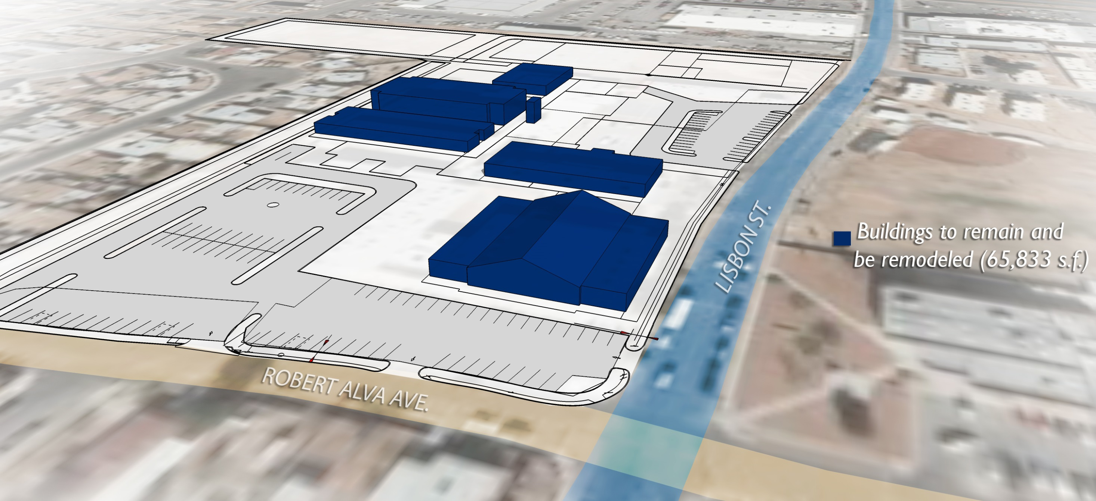
Buildings to be Remodeled

Slide 21
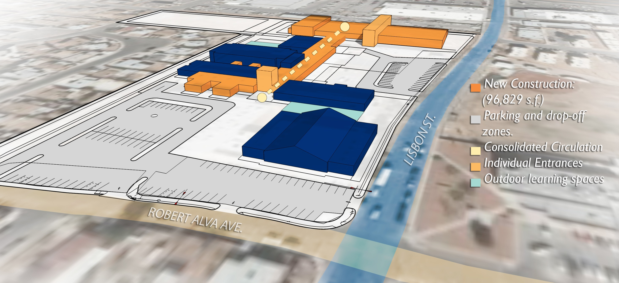
Conceptual Plan

Slide 22
Concept 1 Site Plan
EXISTING FOOTBALL FIELD
Building | (sq. ft.)
New | 88,620
Renovated | 65,833
Demolition | 59,143
OUTDOOR LEARNING
ES
ACADEMICS
ES ACADEMICS
FINE ARTS
CAREER TECHNOLOGY
MS ACADEMICS
ADMIN
MEDIA CENTER
CAFETERIA
ADMINISTRATION / SPECIAL EDUCATION
ROBERT ALVA AVE.
ES GYMNASIUM / MULITPURPOSE
OUTDOOR PLAY AREA
GYMNASIUM
LISBON ST.
EXISTING BASEBALL FIELDS

Slide 23
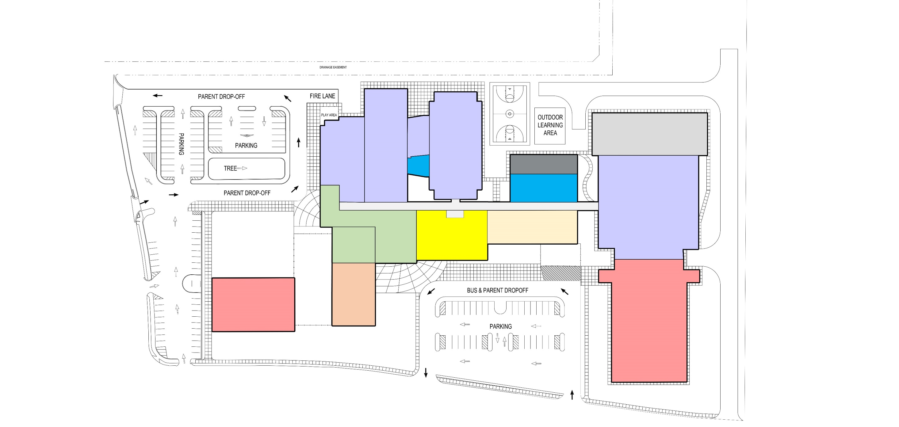
Concept 1 Site Plan Adjacencies
EXISTING FOOTBALL FIELD
FIRE LANE
FACULTY PARKING
ES ACADEMICS
FINE ARTS
SUPPORT
CAREER TECH
MS ACADEMICS
ROBERT ALVA AVE.
CAFETERIA
ADMIN
LIBRARY
FIRE LANE
SVC. PATIO
SPECIAL
EDUC.
MULTIPURPOSE
GYMNASIUM
COVERED OUTDOOR COURTYARD
LISBON ST
PARENT PARKING

Slide 24
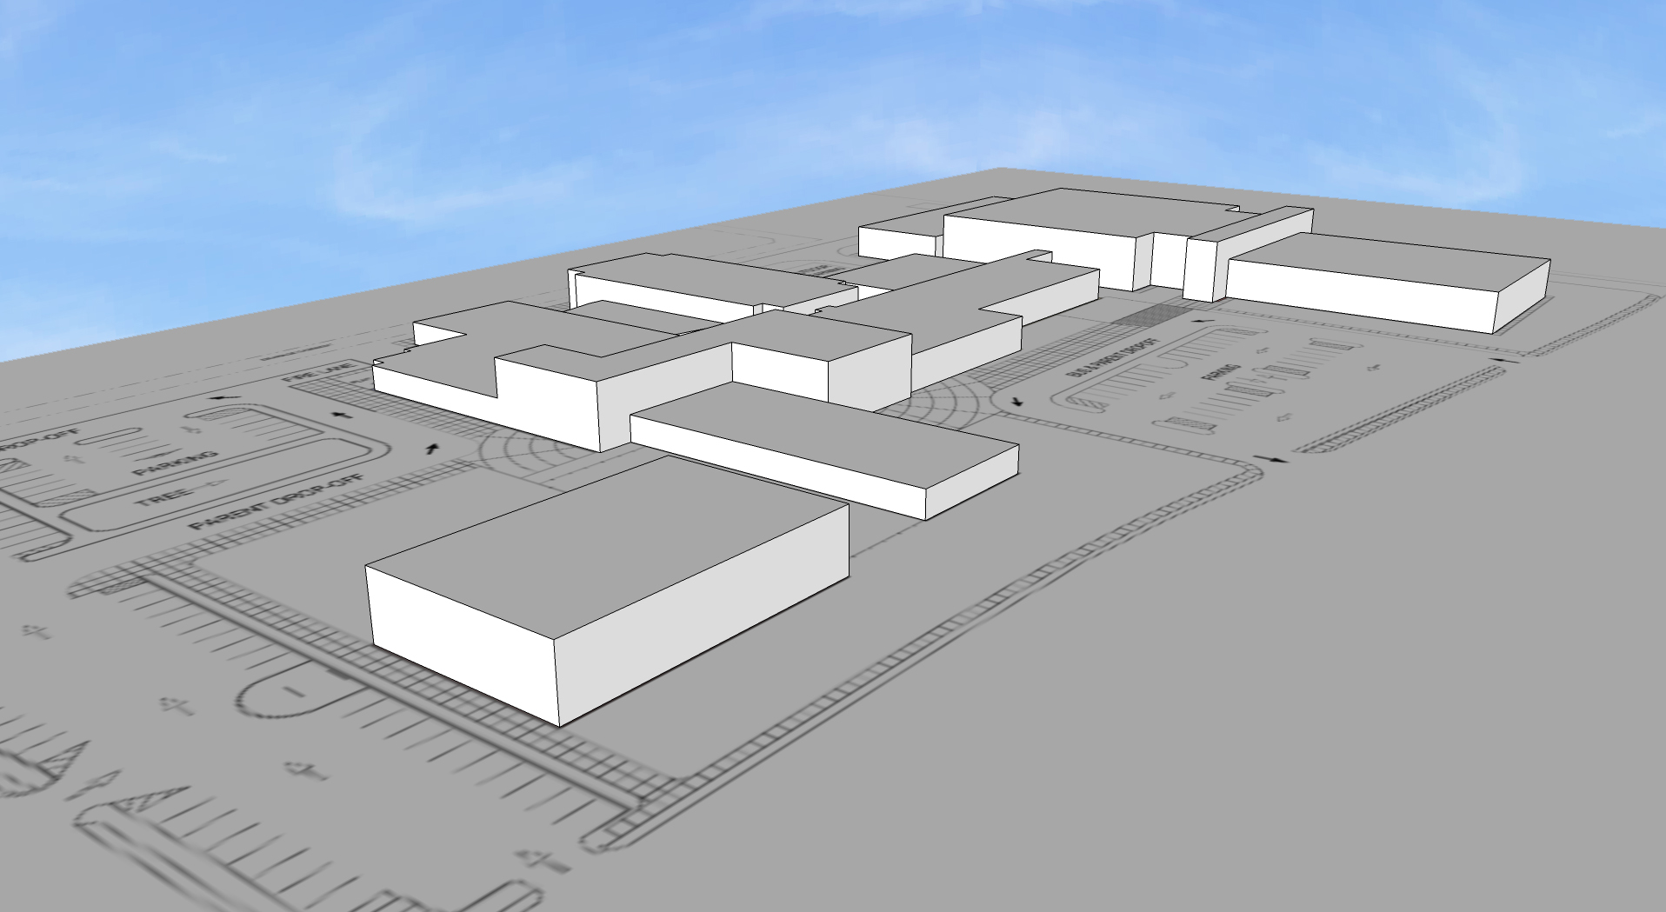
SECONDARY BUILDING ENTRY (FACULTY)
LARGE ATRIUM SPACE:
MAIN GYMNASIUM ENTRY
PRE-EVENT GATHERING
PROMOTE SCHOOL PRIDE
LISBON ST.
MAIN BUILDING ENTRY

Slide 25
Concept 1 Phasing Plan
EXISTING FOOTBALL FIELD
4
OUTDOOR LEARNING
ES
ACADEMICS
ES ACADEMICS
FINE ARTS
4
CAREER TECHNOLOGY
2
MS ACADEMICS
CAFETERIA
1
ADMIN
MEDIA CENTER
ADMINISTRATION / SPECIAL EDUCATION
ROBERT ALVA AVE.
1
3
OUTDOOR PLAY AREA
ES GYMNASIUM / MULITPURPOSE
4
GYMNASIUM
LISBON ST.
EXISTING BASEBALL FIELDS

Slide 26
Concept 2 Site Plan
EXISTING FOOTBALL FIELD
Building | (sq. ft.)
New | 88,620
Renovated | 65,833
Demolition | 59,143
ES
ACADEMICS
ES ACADEMICS
GYMNASIUM
CAREER TECHNOLOGY
CAFETERIA
LIBRARY
SPECIAL EDUC.
ADMIN
ADMINISTRATION / ES ACADEMICS
FINE ARTS
ROBERT ALVA AVE.
ES GYMNASIUM / MULITPURPOSE
OUTDOOR PLAY AREA
MS ACADEMICS
LISBON ST.
EXISTING BASEBALL FIELDS

Slide 27
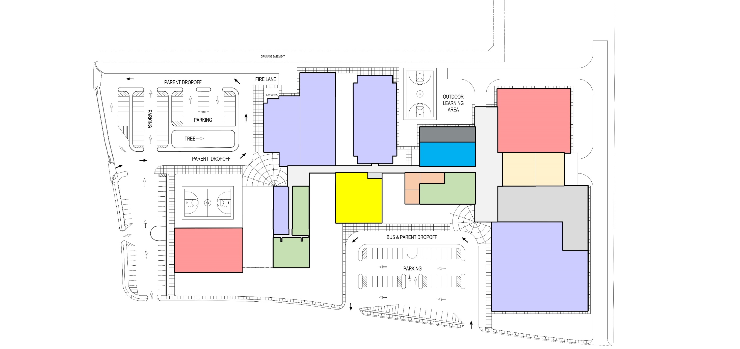
Concept 2 Site Plan Adjacencies
EXISTING FOOTBALL FIELD
FACULTY PARKING
ES ACADEMICS
GYMNASIUM
SUPPORT
CAREER TECH
CAFETERIA
SVC. PATIO
ROBERT ALVA AVE.
SPECIAL
EDUC.
LIBRARY
ADMIN
FINE ARTS
MULTIPURPOSE
ADMIN
MS ACADEMICS
COVERED OUTDOOR COURTYARD
LISBON ST
PARENT PARKING

Slide 28
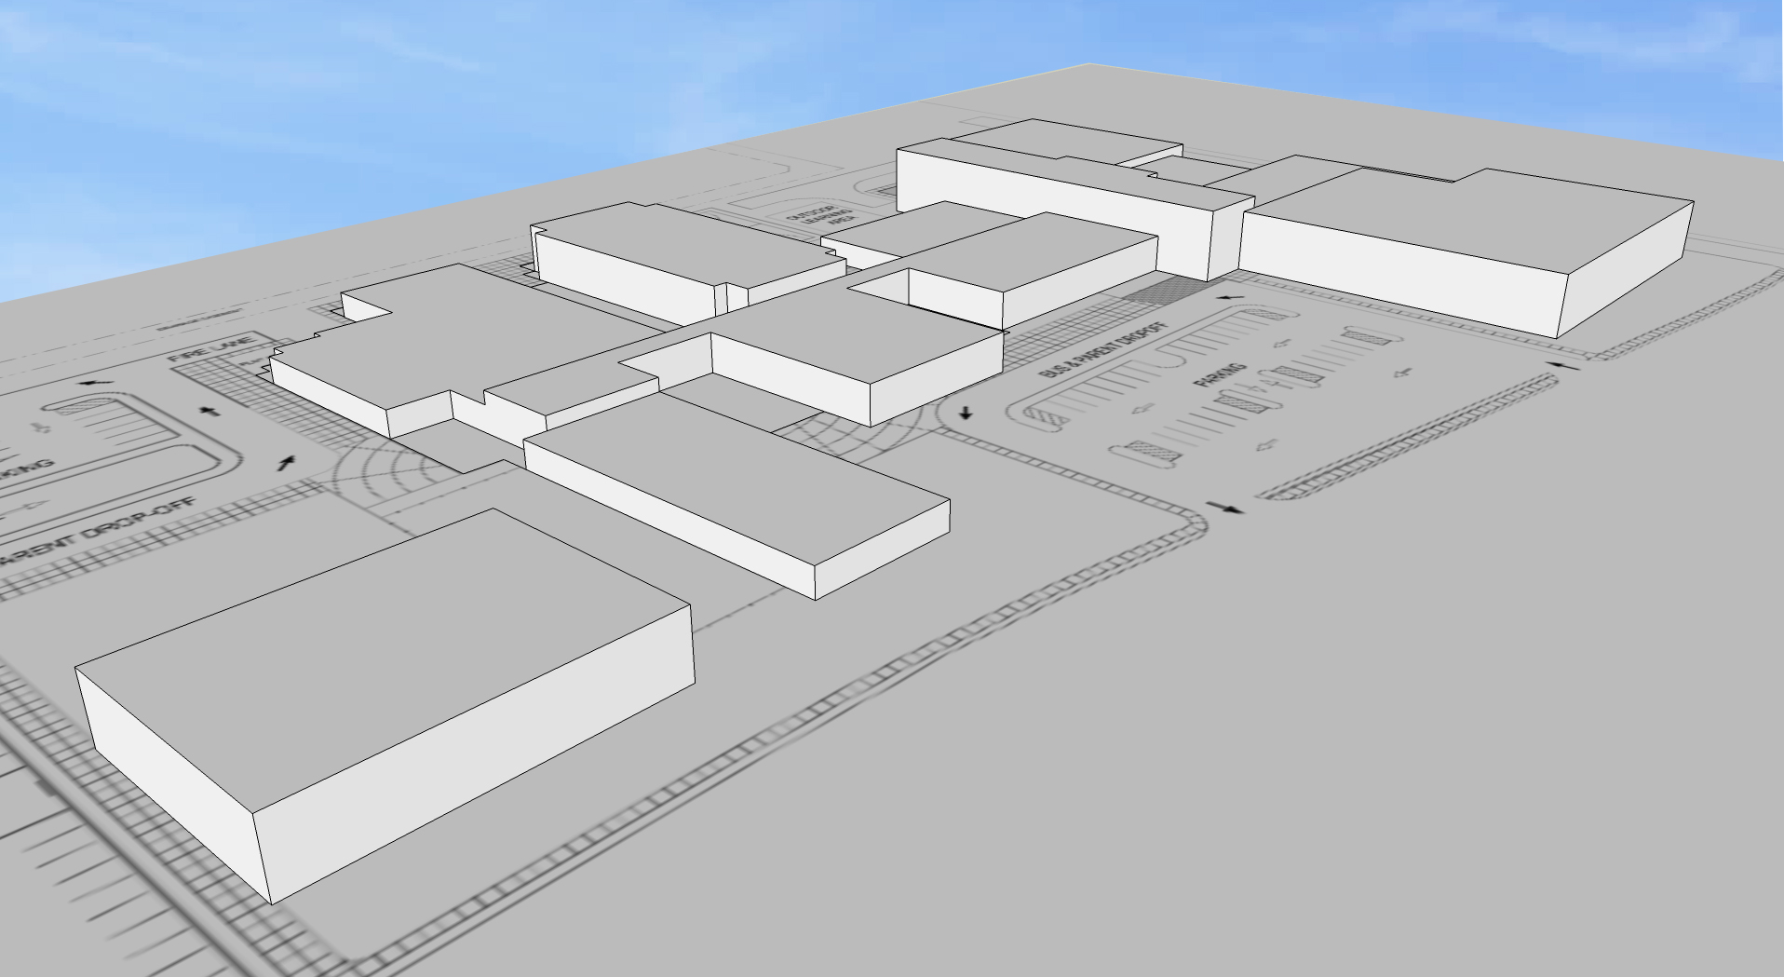
SECONDARY BUILDING ENTRY (FACULTY)
MAIN BUILDING ENTRY / SHARED LOBBY PROMOTES SCHOOL COHESIVENESS BETWEEN ATHLETICS AND ACADEMICS
LISBON ST.

Slide 29
Concept 2 Phasing Plan
EXISTING FOOTBALL FIELD
3
2
ES
ACADEMICS
ES ACADEMICS
3
GYMNASIUM
CAREER TECHNOLOGY
2
CAFETERIA
SPECIAL EDUC.
ADMIN
1
LIBRARY
ADMINISTRATION / ES ACADEMICS
FINE ARTS
ROBERT ALVA AVE.
OUTDOOR PLAY AREA
1
2
ES GYMNASIUM / MULITPURPOSE
MS ACADEMICS
3
LISBON ST.
EXISTING BASEBALL FIELDS

Slide 30
Concept 3 Site Plan
EXISTING FOOTBALL FIELD
Building | (sq. ft.)
New | 88,620
Renovated | 65,833
Demolition | 59,143
ES
ACADEMICS
ES ACADEMICS
CAREER TECHNOLOGY
FINE ARTS
ADMIN
SPECIAL EDUC.
LIBRARY
MS ACADEMICS
ROBERT ALVA AVE.
CAFETERIA
ES GYMNASIUM / MULITPURPOSE
OUTDOOR PLAY AREA
SVC. PATIO
ADMIN
GYMNASIUM
LISBON ST.
EXISTING BASEBALL FIELDS

Slide 31
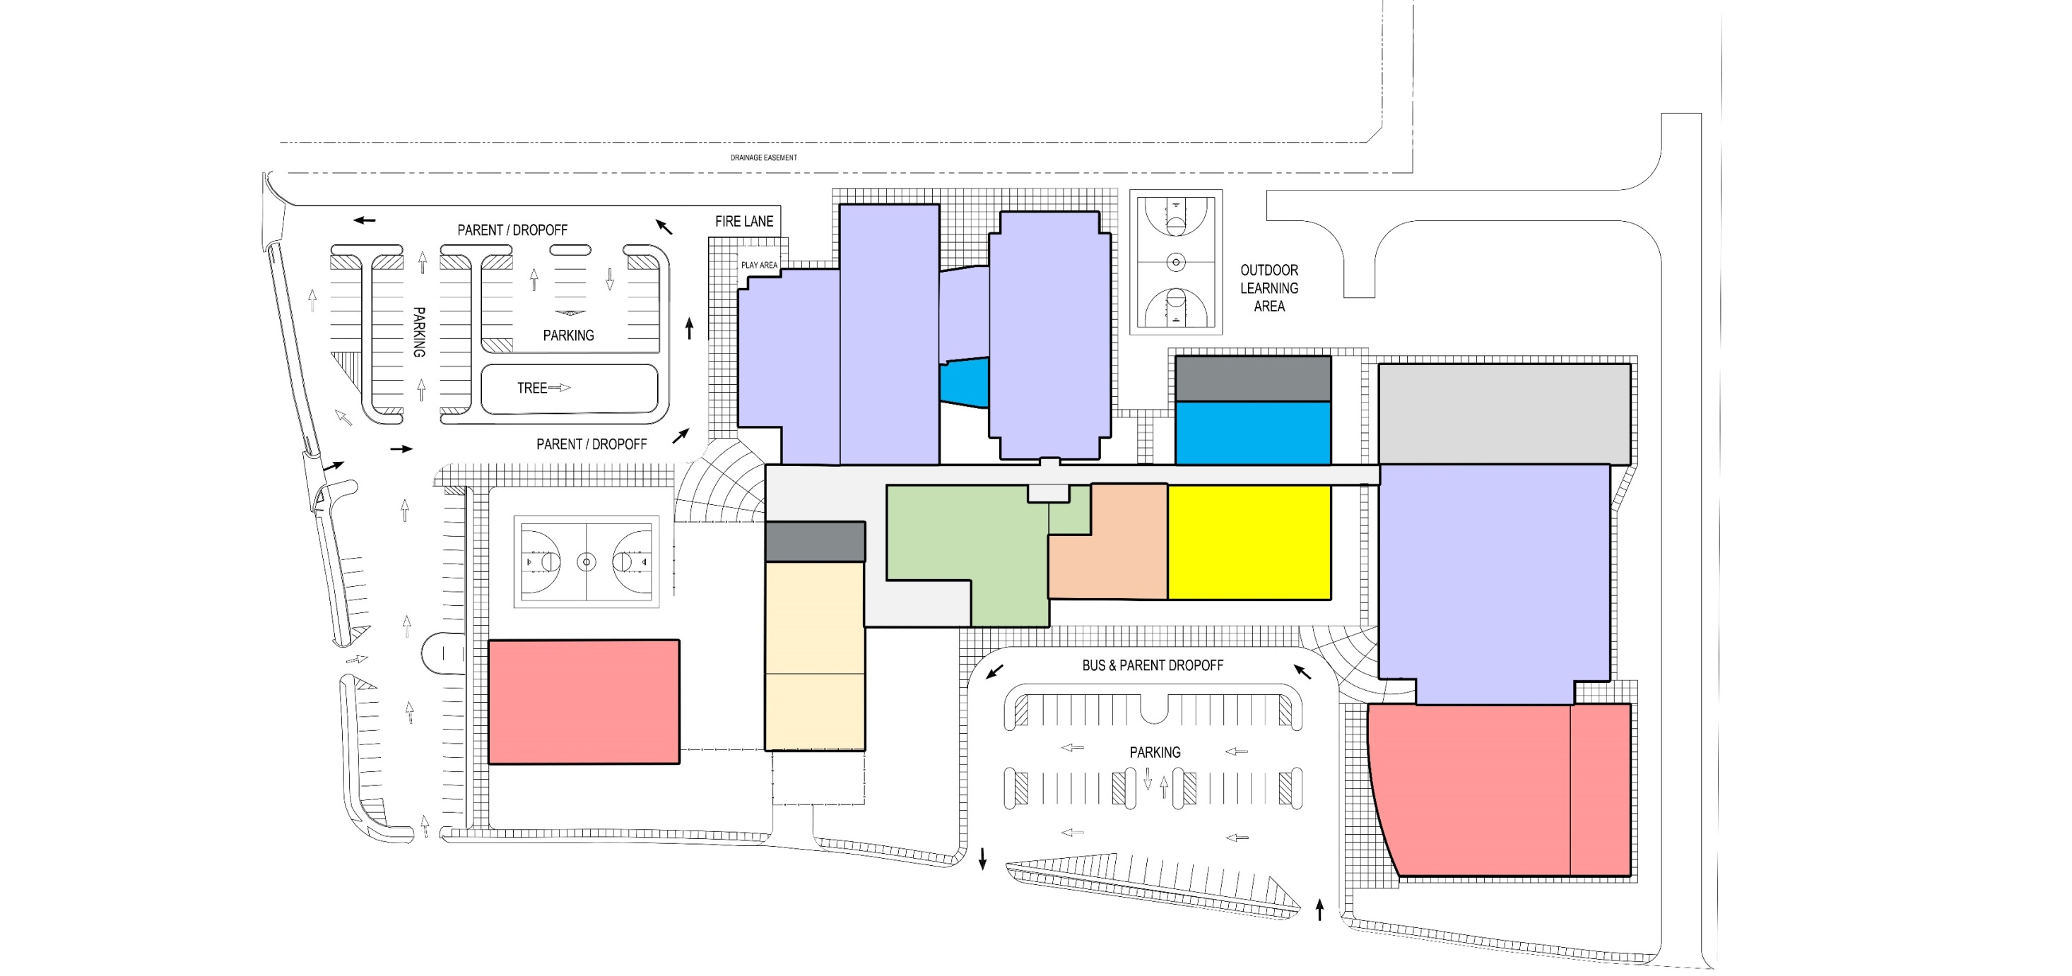
Concept 3 Site Plan Adjacencies
EXISTING FOOTBALL FIELD
FIRE LANE
FACULTY PARKING
ES ACADEMICS
SUPPORT
CAREER TECH
FINE ARTS
ROBERT ALVA AVE.
ADMIN
LIBRARY
FIRE LANE
SPECIAL
EDUC.
MS ACADEMICS
CAFETERIA
MULTIPURPOSE
COVERED OUTDOOR COURTYARD
SVC. PATIO
GYMNASIUM
LISBON ST
PARENT PARKING

Slide 32
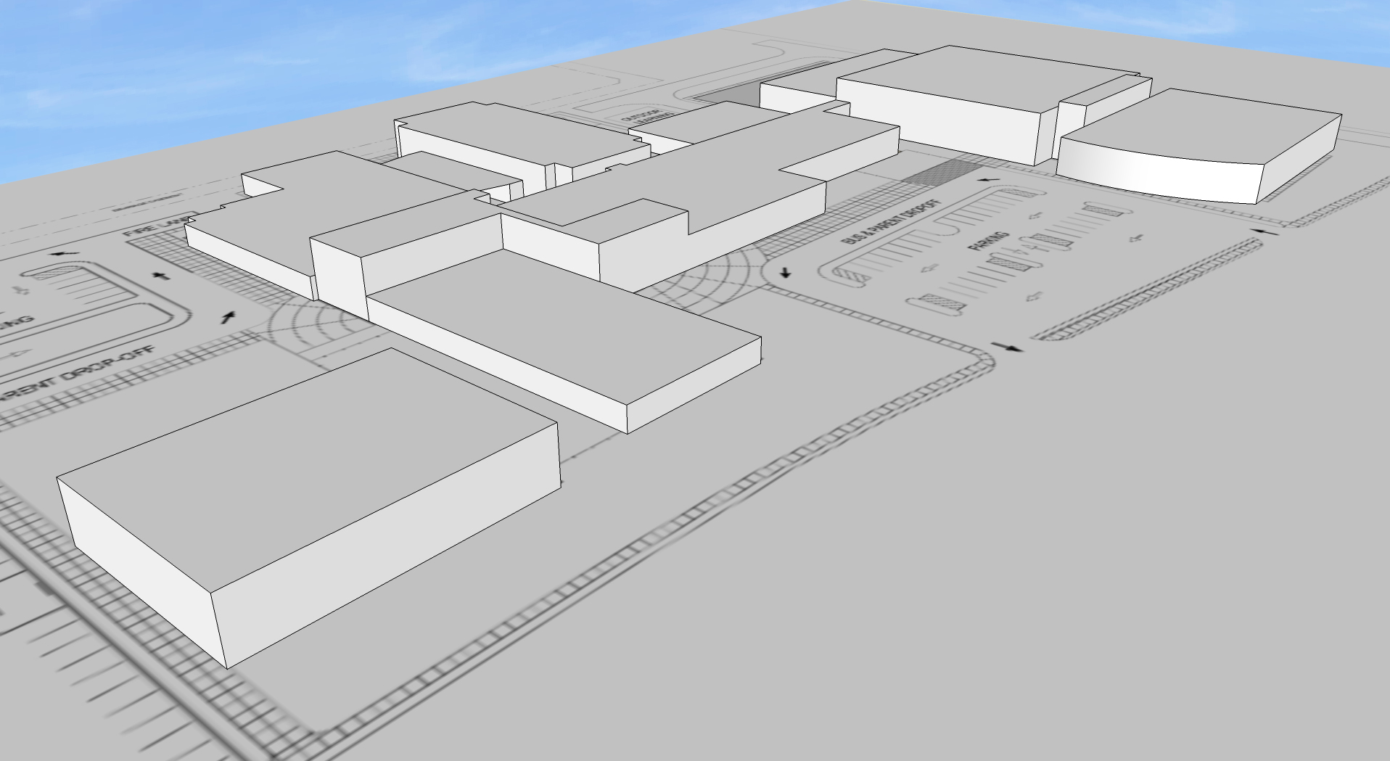
SECONDARY BUILDING ENTRY (FACULTY)
MAIN BUILDING ENTRY
LISBON ST.

Slide 33
Concept 3 Phasing Plan
EXISTING FOOTBALL FIELD
3
ES
ACADEMICS
ES ACADEMICS
4
CAREER TECHNOLOGY
MS ACADEMICS
2
ADMIN
SPECIAL EDUC.
LIBRARY
1
FINE ARTS
ROBERT ALVA AVE.
CAFETERIA
4
OUTDOOR PLAY AREA
4
1
ES GYMNASIUM / MULITPURPOSE
3
ADMIN
GYMNASIUM
LISBON ST.
EXISTING BASEBALL FIELDS

